Slide 1
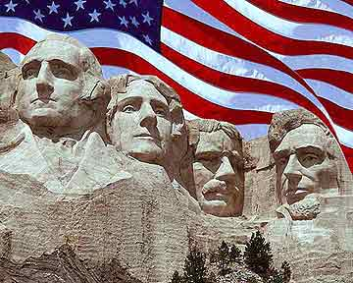
US History Review

Slide 2
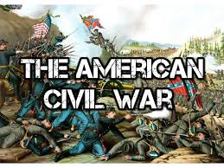

Slide 3
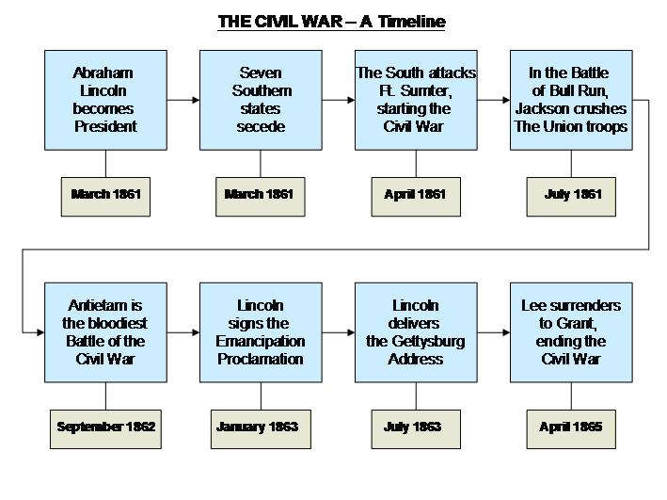

Slide 4
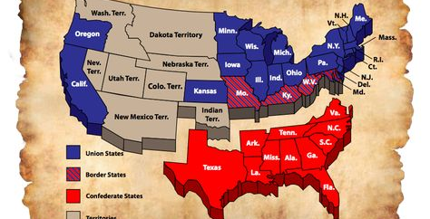

Slide 5
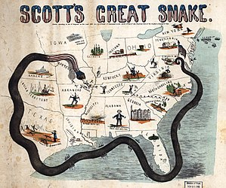

Slide 6
Civil War (April 1861- April 1865)
Long term causes of Civil War:
Sectionalism- South, NE, NW
Slavery- was abolished in Great Britain in 1833; The invention of the cotton gin in 1793 increased the need for slaves in the south, due to the increase in cotton production
Westward Expansion- slave or free states?
Break down of Compromises
Differences in Constitutional Interpretation- more federal Gov’t versus less federal Gov’t
Missouri Compromise 1820:
Missouri applied to be slave state; there were 11 free and 11 slave states Maine was admitted as free state
No slavery in Louisiana Purchase north of southern boundary of Missouri
Compromise of 1850:
California admitted as free state
Popular sovereignty applied to territories taken from Mexico
Harsher fugitive slave laws- required northerners to return runaway slaves

Slide 7
Civil War (April 1861- April 1865)
Long term causes of Civil War:
Harriet Beecher Stowe- best known for her novel Uncle Tom's Cabin (1852), which depicts the harsh conditions for enslaved African Americans; book reached millions, and became influential in the United States and Great Britain, energizing anti-slavery forces in the American North, while provoking widespread anger in the South
Kansas-Nebraska Act 1854
divided Nebraska territory into Nebraska and Kansas and repealed Missouri Compromise by applying popular sovereignty
Bleeding Kansas (1854-1861)- slavery and anti-slavery forces fought to determine whether Kansas would become a free state or a slave state; popular sovereignty was to be used to determine this outcome
Dred Scott- he sued his owner because he lived in free states for years (Fort Emerson- Wisconsin territory) – he got married & had kids during that time, when they returned to Missouri, he sued for his freedom; Supreme Court (March,1857) ruled that because he was not a citizen he could not sue in federal court; court held that prohibition of slavery in northern territories by the Missouri Compromise was unconstitutional; was freed shortly after, however died in September 1858
John Browns Raid (1859)-White abolitionist killed five supporters of slavery in 1856 in Kansas.
1859 led a raid on Federal Armory at Harpers Ferry; was captured and hanged

Slide 8
Immediate Causes of War
Election of Abraham Lincoln (1860)- 16th president
Secession of South Carolina- December 1860
Other states followed
Southern States formed the Confederate States of America(Feb 1861)- Jefferson Davis President
Shots fired on Fort Sumter (April 12, 1861)
Border States- Missouri, Kentucky, West Virginia, Maryland, Delaware

Slide 9
Course of War:
Anaconda Plan; (Gen. Winfred Scott-Union) Naval blockade in the Southern Ports; seize control of Mississippi & divide confederacy in two and strangle them
Battle of Bull Run; July 22, 1861, first major battle of war- Virginia
Battle of Antietam(Maryland); September 17, 1862 bloodiest single day battle
Emancipation Proclamation; happened 5 days after Antietam- freed slaves in rebel states
Battle of Gettysburg(Pennsylvania); July 1863 – considered turning point of war - along with Vicksburg
Gettysburg Address (Nov 19, 1863)-proclaimed the Civil War as a struggle for the preservation of the Union with "a new birth of freedom that would bring true equality to all of its citizens. Lincoln also redefined the Civil War as a struggle not just for the Union, but also for the principle of human equality.
Vicksburg; May 18 – July 4 1863 (Mississippi) – Last major confederate stronghold on Mississippi River – completed 2nd Part of Anaconda Plan
Sherman's March to the Sea (1864)-began with Sherman’s (Gen. William Tecumseh Sherman) troops leaving the captured city of Atlanta on November 15 and ended with the capture of the port of Savannah on December 21. Forces followed a "scorched earth" policy, destroying military targets, industry, infrastructure, and civilian property. disrupted the Confederacy's economy and transportation networks. Operation broke the back of the Confederacy and helped lead to its eventual surrender
April 9 1865; General Lee surrenders to Grant at Appomattox Courthouse
Ulysses Simpson Grant- March 2, 1864, Lincoln promoted Grant to lieutenant general, giving him command of all Union Armies, answering only to the president
Robert E. Lee- commander of the confederate army

Slide 10
Consequences of Civil War
13 Amendment; outlawed slavery 1865
14 Amendment (1868); All persons born in US are naturalized citizens; gave citizens due process
15 Amendment (1870); All citizens can vote regardless of race; did not allow women to vote
Ostend Manifesto; 1854 document rational for US buying Cuba (to use as a slave colony) from Spain – Never happened
Adams-Onis Treaty 1819- between the U.S. and Spain; ceded Florida to the U.S.
1840 Florida admitted as slave state and Iowa as free state
January 10, 1861- Florida Seceded from the Union
Florida was major supply route for Confederates during the Civil War- Union forces operated a naval blockade around the state.
Fort Zachary Taylor in Key West controlled by Union was used to deter supply ships from provisioning Confederate ports in the Gulf of Mexico

Slide 11
Abolitionists
Fredrick Douglas;
(1818-95) was a prominent American abolitionist, author and orator. Born a slave, Douglass escaped at age 20 and went on to become a world-renowned anti-slavery activist
Sojourner Truth; Born Araminta Ross as a slave in Dorchester County, Maryland
(1797-1883) was an abolitionist and women's rights activist. Born into slavery in New York, escaped with her infant daughter to freedom in 1826. After going to court to recover her son, in 1828 she became the first black woman to win such a case against a white man. Gave herself the name Sojourner Truth in 1843 after she became convinced that God had called her to leave the city and go into the countryside testifying the hope that was in her
Harriet Tubman;
1822 – March 10, 1913) was an American abolitionist, humanitarian, and an armed scout and spy for the United States Army during the Civil War. Born into slavery, Tubman escaped and made some thirteen missions to rescue approximately seventy enslaved people, family and friends,^{[2]} using the network of antislavery activists and safe houses known as the Underground Railroad. She later helped abolitionist John Brown recruit men for his raid on Harpers Ferry, and in the post-war era was an active participant in the struggle for women's suffrage.

Slide 12
Reconstruction 1865-1877

Slide 14
Reconstruction-(1863-1877)
Lincoln; very lenient on south- proposed ten percent plan(introduced in 1863)- once 10% of states voters pledged to union and accepted the Emancipation Proclamation, they could be readmitted -congress rejected introduced the Wade Davis Bill (1864) by radical Republicans; more stringent on the south- passed both houses but Lincoln pocket vetoed bill.
Assassinated by well-known stage actor John Wilkes Booth on April 14, 1865, at play- Our American Cousin- Ford's Theatre in Washington, D.C.
Freedmen’s bureau- March 1865 help former slaves adjust to freedom
Andrew Johnson – replaced Lincoln 17th President – pardoned many confederate leaders – who were then elected to congress; Republicans were outraged & congress refused to seat the newly elected Southern leaders; Presidential Reconstruction- 1865-1866- very lenient on the south
Black Codes – Based on slave codes of the past; defined freemen – “Persons of Color” – can’t serve on juries/can’t vote, can’t marry whites, can’t travel freely
Republicans then passed a Civil Rights Act 1866 & a bill to enlarge the freedman’s bureau, Johnson vetoed them but Republicans had enough votes to override him. Congress rewrote the Civil rights Act into the 14th amendment- all people born or naturalized in the United States are citizens

Slide 15
Radical or Congressional Reconstruction
Radical Republicans passed a bill Reconstruction Act 1867(military reconstruction), to divide the South into 5 districts – each district was occupied by a division of the Union Army & placed under Marshall Law. Carpetbaggers went south to run these districts
Carpet baggers – Northern leaders who came to the South to lead the new Southern governments- many were poor whites
Scalawags – Southern whites who supported reconstruction
June 25, 1868 Florida was readmitted to the Union
Election of 1868- many blacks elected to state governments in south. Georgia and south Carolina had a majority black population
Redeemers- the conservative faction in the Democratic Party, pursued policy of Redemption, to oust the Radical Republicans. Generally led by rich landowners, businessmen and professionals, dominated Southern politics from the 1870s to 1910.
Tenure of Office Act – limiting the president’s power to dismiss his own cabinet – Johnson refused to obey; firing sec of war (Ed Stanton) 1868; congress tried to impeach; House of Representatives did, senate fell one vote short
Sharecropping – Landowner provided cabin, mule, took a plot of land. Sharecropper gave a large share of his crop to the land owner.
Tenant farmers – they rented land from land owners, but provided their own tools.
15th Amendment(1870) - Gave all males the right to vote regardless of color
Hiram Rhodes Revels; first black to sit in congress- senator in Mississippi 1870

Slide 16
Ulysses S. Grant
18th president of the United States from 1869 to 1877
Grant welcomed black troops during the Civil war
Supported Reconstruction and enforced the protection of African Americans in the South through the use of the Enforcement Acts . He used them to combat the Ku Klux Klan, which was essentially wiped out.
Enforcement Acts- three bills passed by the United States Congress between 1870 and 1871. criminal codes which protected African-Americans’ right to vote, to hold office, to serve on juries, and receive equal protection of laws. Also allowed the federal government to intervene when states did not act to protect these rights.

Slide 17
Reconstruction Ends
Reconstruction ends- election of 1876; Rutherford B. Hayes(R) v. Samuel Tilden (D)
Tilden won popular vote but not electoral- 3 southern states were disputed- Florida, S. Carolina, and Louisiana- Compromise of 1877; gave the electoral votes to Hayes- he agreed to withdraw troops from the south and end reconstruction
This lead to the south reinstating the former confederate government and depriving blacks of their civil rights. The governments implemented; literacy tests, poll taxes, and grandfather clauses. By utilizing these rules, they were able to prevent blacks from voting. They were also able to enact Jim Crow laws in the south.
Jim Crow Laws – laws establishing racial segregation in the South (separate but equal facilities)- Instituted after reconstruction ended
Nadir- the period in the history of the Southern United States from the end of Reconstruction in 1877 through the early 20th century, when racism in the country was worse than in any other period after the American Civil War.
Poll Tax- a tax levied as a fixed sum on every liable individual. Due to grandfather clauses, they applied to blacks only after reconstruction ended.
Literacy Tests- Blacks were required to take a Literacy test and if they missed one question, they would be prohibited from voting
Plessy v. Ferguson, (1896), upheld the constitutionality of racial segregation laws. After Plessy took a seat in the whites-only railway car, he was asked to vacate it, and sit instead in the blacks-only car. Plessy refused and was arrested

Slide 18
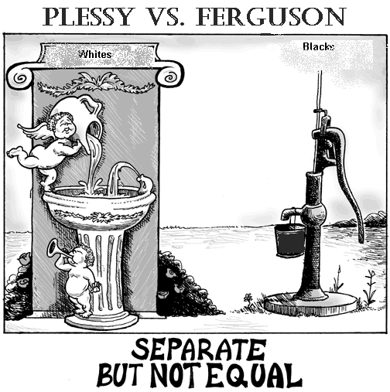
II. Social & Cultural Changes
8. Southern Schools & Segregation-
a. South lagged; fewer weeks in school year; some refused compulsory education
b. Segregation in Schools by Law: 1876- NC & AL, 1877- SC & Louisiana, 1878- Mississippi, 1882- Virginia
c. Plessey vs. Ferguson- segregation upheld by US Supreme Court in Plessey v. Ferguson 1896 “Separate, but Equal” (hurt financially); wave of Jim Crow Laws follow
http://courtcases.wikispaces.com/file/view/Plessy_Vs._Ferguson.GIF/58588602/714x523/Plessy_Vs._Ferguson.GIF

Slide 19
Settling The West

Slide 20
Settling The West
May 20, 1862, the Homestead Act provided settlers 160 acres of public land. Homesteaders paid a small fee and had to complete five years of continuous residence before receiving ownership of the land. After six months of residency, they could purchase the land from the government for $1.25 per acre.
The Great Plains grassland, that lies west of the Mississippi River tallgrass prairie states and east of the Rocky Mountains in the United States and Canada
Open Range- Public lands not belonging to anyone- cowboys used this for cattle to graze during the ”long drives”
Long drives- cowboys taking cattle (usually north) to nearest railroad to ship beef east
boomtown is a community undergoes rapid population and economic growth, or is new because of an influx of people. Normally attributed to the discovery of a resource such as gold, silver, or oil.
push-pull factors are those that drive people away from a place and draw people to a new location
Barbed Wire- fencing material made out of twisted wire with spaced coiled barbs. turned the open plains of the West into enclosed pastures and forever changed the society and economy of the region

Slide 21
Transcontinental Railroad, completed-1869
Original built by European immigrants, however many of them left to go and try to find gold; then RR companies used a lot of Chinese labor to complete
Connected the entire country; what previously took several months to go from coast to coast could now be done in several days.
Helped to create a national market; U.S. entered new age of technology
Union Pacific began in Omaha in 1865 and went west. Central Pacific went east from Sacramento and met the Union Pacific Railroad at Promontory Point, Utah.

Slide 22
Native Americans
In 1838 and 1839, Andrew Jackson's Indian removal policy, Cherokee nation was forced to give up its lands east of the Mississippi River and migrate to present-day Oklahoma. Called the "Trail of Tears," because of its devastating effects.
Establishment of Indian Reservations; Completion of railroad made land out west desirable- Indians will fight back from 1864-1890 (Indian Wars)
1851- Indian Appropriations Act authorized the creation of Indian reservations in modern-day Oklahoma.
Sioux Indians groups of Native American tribes and First Nations peoples in North America- comprise three major divisions based on language divisions: the Dakota, Lakota, and Nakota.
Custer vs. Sitting Bull (Lakota Chief and Holy man) - Battle of Little Bighorn (Montana)- June 25, 1876
Custer and his men were outnumbered, and Custer will make a tactical mistake. Custer and his men (all 264 of them) were killed, by Crazy Horse (Sioux warrior leader)
Wounded Knee Creek (December 29, 1890 South Dakota )- last major armed conflict between the Lakota and the United States- 150 Lakota Sioux were killed
Dawes Act (1887)-distribution of Indian reservation land among individual tribesmen, aim of creating responsible farmers in the white man’s image Americanization of Indians; also sent Indian children to schools in the east for americanization- terrible for the indians
Buffalo Soldiers- established by Congress as the first peacetime all-black regiments in the regular U.S. Army. This nickname was given to the Negro Cavalry by Native American tribes who fought in the Indian Wars
California Gold Rush January 24, 1848- 1855, gold was found Coloma, (Northern) California. The news brought approximately 300,000 people to California

Slide 24
Second Industrial Revolution
A phase of rapid industrialization in the final third of the 19th century and the beginning of the 20th, generally dated between 1870 and 1914 up to the start of World War I.
Industries; Railroads
Oil
Steel
Electricity

Slide 25
Foundations of Industrial Revolution
Abundant Natural Resources
“Free Enterprise” System
Role of Government- “laissez Faire” capitalism
Legacy of First Revolution
Economic Stimulus of Civil War
Rise of Corporations- Stocks, economies of scale, cheap labor
Growing Population, National Market
Horizontal Integration Vertical Integration

Slide 26
Laissez-faire -A theory that the economy does better without government intervention in business.
Market Economy; all factors of production are privately owned; people free to buy and sell goods in the open market
Invention- something newly designed or created, or the activity of designing or creating new things.
Innovation- a new idea, device, or method the act or process of introducing new ideas, devices, or methods
Social Darwinism - survival of the fittest in human society
Monopoly- company has complete control over a product or service in that area.
Example: Standard Oil - Dangers of Monopolies- Inferior products, unlimited price increases
vertical integration is an arrangement in which all of the stages of production of a company is owned by that company
horizontal integration – controlling all companies and faculties at one stage of production
Market Economy; all factors of production are privately owned; people free to buy and sell goods in the open market
Stock- Ownership in a company
Corporation-a company or group of people authorized to act as a single entity (legally a person) and recognized as such in law.

Slide 27
Entreprenurial Spirit
Entrepreneur-a person who organizes and operates a business or businesses, taking on greater than normal financial risks in order to do so.
John D Rockefeller-American oil industry business magnate Oil, Horizontal Integration- Standard Oil Trust- is considered to be the wealthiest American of all time by virtually every source
Andrew Carnegie- brought Bessemer process to U.S.- He built Pittsburgh's Carnegie Steel Company,(Vertical Integration) which he sold to J.P. Morgan in 1901 for $480 million
John Pierpont "J.P." Morgan - American financier and banker
Henry Morrison Flagler- key figure in the development of the Atlantic coast of Florida and founder of what became the Florida East Coast Railway. Also a founder of Standard Oil w Rockefeler
Henry Ford (July 30, 1863 – April 7, 1947) captain of industry, business magnate, founder of Ford Motor Company. sponsored assembly line technique of mass production. Ford didn’t invent automobile or assembly line, he developed and manufactured the first automobile that many middle-class Americans could afford. Ford converted automobile from an expensive curiosity to practical conveyance. His introduction of the Model T automobile revolutionized transportation and American industry

Slide 28
Entreprenurial Spirit
Government attempts at regulation:
Court cases: Wabash v. Illinois (1886)- Supreme court ruled that railroads can only be regulated by federal government- interstate commerce
Munn v. Illinois (1877)- court ruled that state can regulate because its in the public’s interest
Acts: Interstate Commerce Act (1887)- regulates Railroads- in response to Wabash case
Sherman Antitrust Act (1890)- regulates monopolies; vague and hard to enforce

Slide 29
Inventors
Bessemer process (Henry Bessemer)- inexpensive industrial process for the mass-production of steel
George Pullman – sleeping car
Alexander Graham Bell -patented first telephone
Thomas Edison- patented first light bulb; many other inventions- phonograph, the motion picture camera-
Nicola Tesla- developed Alternating Current; 1893 lit up worlds fair in Chicago
Black Inventors:
Elijah McCoy- lubricators for steam engines
Sarah Goode- fold away bed
Garrett Morgan- safety hood & smoke protectors for fire fighters
Sarah Breedlove, known as Madam C. J. Walker, first female self-made millionaire in America, became one of the wealthiest African American women in the country. Made her fortune by developing and marketing a line of beauty and hair products for black women

Slide 31
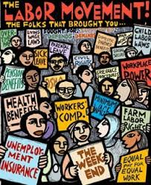
Labor Unions
A labor union is an
association of workers who
join together to promote and
protect the welfare, interest,
and rights of its members by
a process called Collective
Bargaining.

Slide 32
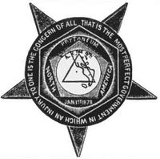
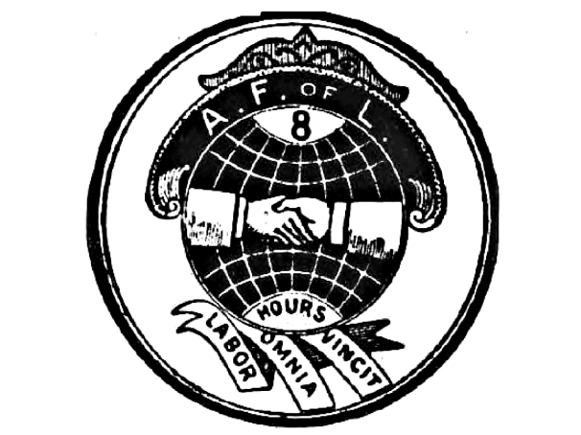
Examples of Labor Unions
Knights of Labor
An American labor union originally established as a secret fraternal order and noted as the first union of all workers. It was founded in 1869.
American Federation of Labor
Began in 1886 with about 140,000 members; by 1917 it had 2.5 million members. It is a federation of different unions. Founded by Samuel Gompers

Slide 33
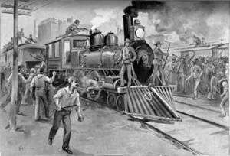
Labor Practices
Collective Bargaining - Discussions held between workers and their employers over wages, hours, and conditions.

Slide 34
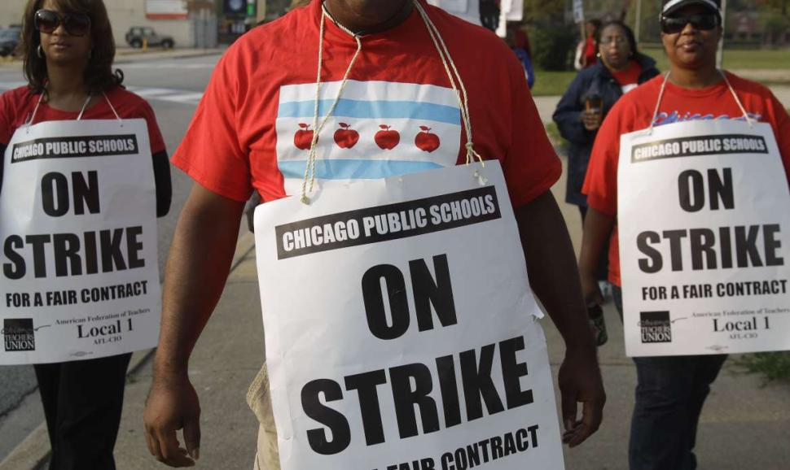
Tactics of Labor - Strike
This is a work stoppage intended to force an employer to respond to workers demands.

Slide 35
Strikes
Haymarket Riot: May 1, 1886
Workers went on strike in favor of 8 hour work day- gathered in front of McCormick machine factory in Chicago- an anarchist threw a dynamite bomb at police and killed one; then police opened fire and 6 cops and 4 demonstrators died
Homestead Strike: June 30, 1892
steelworkers went on strike at Carnegies steelworks at Homestead Pennsylvania eventually the state militia was called in. Carnegies partner Henry Frick brought in strike breakers (Scabs) to run the mill. The union eventually collapsed
Pullman Strike: May 11, 1894
Workers in pull man Illinois went on strike to protest George Pullman who lowered wages for his workers, but did not lower rents. Labor leader Eugene V. Debs (helped form the American Railway Union)called on them to strike. President Cleveland sent in the military on grounds that the mail had to be delivered and the strike interfered with interstate commerce- destroyed the railway union

Slide 37
Urbanization- the social process whereby cities grow and societies become more urban
Assimilation- to absorb into the culture of where you are living

Slide 38
Communism- common ownership of the means of production and the absence of social classes, money and the state. Revolution will put the working class in power and in turn establish social ownership of the means of production.
Socialism- social ownership and democratic control of the means of production
Socialism is an economic system while communism is both an economic and political system. ... Socialists can own personal properties while communists cannot. Socialism allows capitalism to exist in its midst while communism seeks to get rid of capitalism.
Tenements- housing that meets minimum standards for safety and sanitation- usually overcrowded

Slide 39
Political Machines
1. Purpose- traded services for poor in exchange for votes
2. Structure- Boss → Wards → precinct captains
3. Locations- Most infamous NY- Tammany Hall 1850s- 1930s (Democrats); but in many cities such as Chicago, Philadelphia & San Francisco

Slide 40
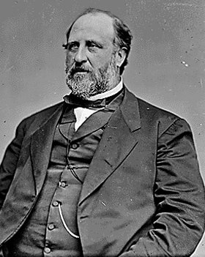
William M. Tweed
Political Boss that was the head of the New York City Political Democratic Machine called Tammany Hall. He ran the machine in the late 1860’s and early 1870’s.
Under his leadership, the “Tweed Ring” stole as much as $200 million dollars from the city.

Slide 41
Immigrants
Old Immigrants (before 1880): most came to escape religious and political persecution or great hardships. Example; the Irish came because of potato famine in 1840. They spoke English
New Immigrants (1880-1924): from southern and eastern Europe- Italians, poles, Jews, and Greeks came in large numbers; many were poor and uneducated- they came to escape religious and political persecution.

Slide 42
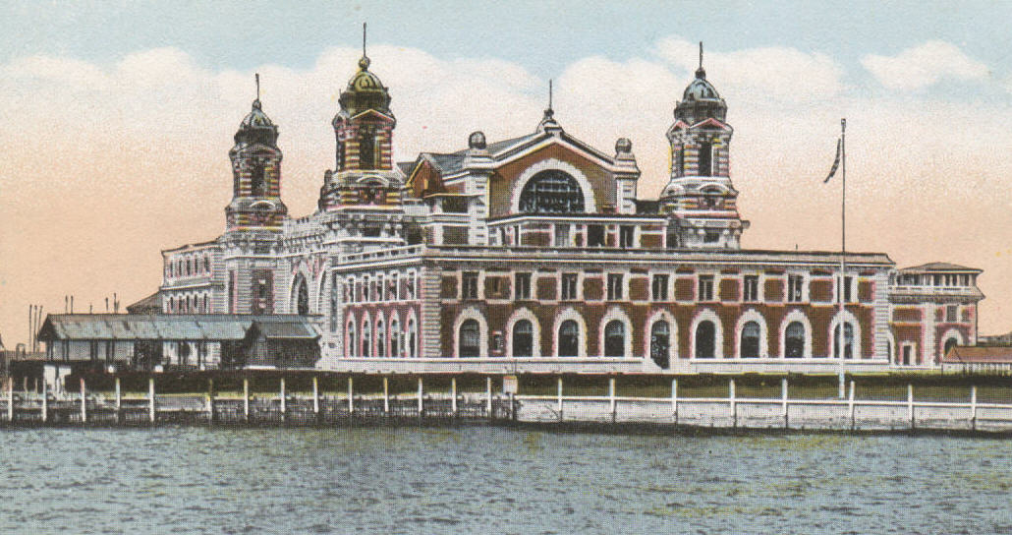
Ellis Island
Located in New York Harbor, it served as
an immigration station for millions of immigrants arriving in the U.S. from Europe between 1892 and 1954.

Slide 43
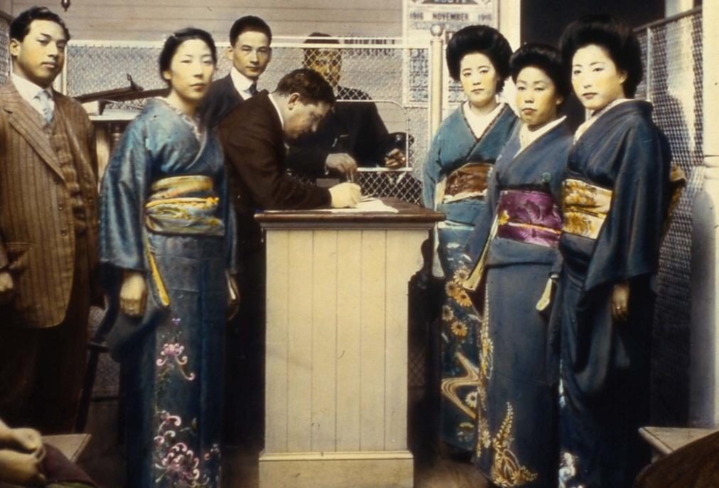
Angel Island
Asians-primarily Chinese, arriving on the U.S. West Coast were processed at this immigration station in San Francisco Bay,
California between
1910 and 1940.

Slide 44
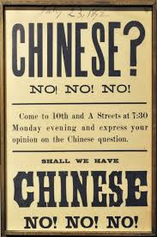
Chinese Exclusion Act
A law, enacted in 1882, that prohibited
All Chinese except students,
teachers, merchants, tourists,
and government officials from
entering the U.S. The law was
not repealed until 1943.

Slide 45
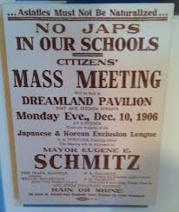
Gentlemen’s Agreement
In San Francisco the Board of Education in 1906 took all Asian school children and placed them special Asian Schools. As a result Anti-American riots broke out in Japan. In 1907-1908 an agreement was reached in which
Japan agreed to limit Japanese
emigration to the U.S. and in return
San Francisco withdrew its
segregation orders.

Slide 46
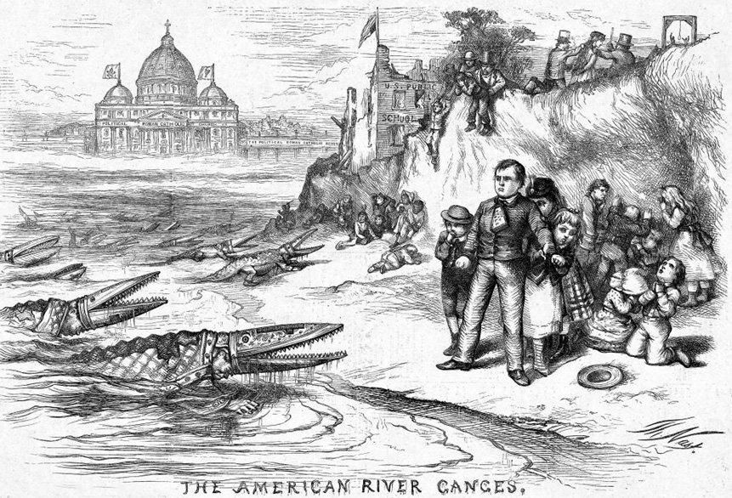
Nativism
An anti-foreign feeling that arose in the 1840's and 1850's in response to the influx of Irish and German Catholics.

Slide 47
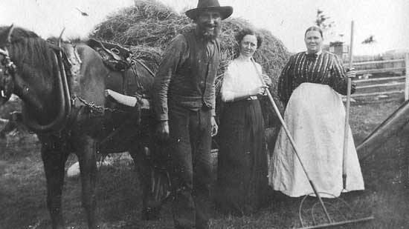
Farmers

Slide 48
Problems facing farmers (1870-1920)
Agricultural Overproduction-
Opening of Great Plains; meant more farmers
Improved machinery meant more production
International competition- RR & Steamboat created new markets
Scarcity of Money; Gov’t stopped minting silver; As population grew & value of goods grew there wasn’t enough money in circulation
High Shipping costs; RR could charge what they want
Farm debt and cost of money; banks charged high interest on loans
High cost of Manufactured products; kerosene, fertilizer, machinery

Slide 49
Repealed in 1893 when country was in depression.
Required Gov’t to purchase a large amount of silver each month- Farmers hoped it would increase the money supply
Sherman Silver Purchase Act (1890)

Slide 50
Grange Movement (1867)
Started by Oliver Hudson

Slide 51
Grange movement
National Association of Farmers
Wanted to modernize farming
Elected candidates in state legislature
Passed laws regulating RR and grain storage rates
Granger laws; Elected state legislatures who passed new laws regulating railroad rates and grain storage rates

Slide 52
Populist Party (1892-1896)
Farmers formed regional Political Associations- Farmers Alliances
Early 1890’s Farmers Alliances leaders formed a new national political party; “Peoples Party” better known as Populist Party

Slide 53
Populist platform of 1892- Omaha Platform
Key provisions;
Direct election of senators
Secret ballots
8 hour workday for industrial workers
Term limit for presidents(they wanted only one)
Initiatives(voters could introduce bills directly on ballot)
Referendums (direct vote on an issue- voters could change proposed legislation
They got 5 Senators elected

Slide 54
Election of 1896
Populists wanted free coinage of silver; the money supply was still low and they thought this would increase money supply
Democratic convention 1896; Grover Cleveland (incumbent) Dem
Free silver democrats defeated Clevelands supporters; William Jennings Bryan won nomination- delivered famous Cross of Gold Speech
Mckinley (Rep) defeated Bryan
Bryan ran again in 1900 & 1908 and lost

Slide 55
Munn v. Illinois (1877)
Illinois passed law regulating grain elevators
Supreme court ruled that state Gov’t could regulate a private utility if that utility was serving the public interest
Wabash V. Illinois (1886)- invalidated many Granger laws- Supreme court ruled that states could not sue railroads as they were subject to interstate commerce rules and therefore only the federal government could regulate them
Interstate Commerce Act (1887) in response to Wabash case

Slide 56
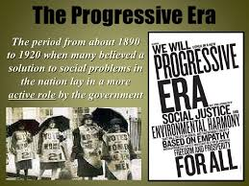

Slide 57
The Progressive Era: period of widespread social activism and political reform 1890s to the 1920s. The main objective of the Progressive movement was eliminating corruption in government

Slide 60
Reasons for Progressive Movement
Reform tradition- based on belief that society can be improved
Legacy of Populism
Problems of Industrial society- working conditions, child labor, political corruption, urban overcrowding, etc
Influence of middle class- Populisim was rural, appealing mostly to the south and west. Whereas progressivism was urban, middle-class and nationwide
Social Gospel movement- middle class progressives acted out of a sense of moral responsibility derived from religion; members also promoted Temperance- calling for a ban on alcohol
New forms of journalism- Muckrackers
Rising consumer consciousness

Slide 61
Reformers
Muckrakers- journalists who exposed the abuses and corruption of industrial society. Famous muckrackers;
Ida Tarbell- wrote about Rockefeller, standard oil, and the ruthless business practices he used.
Upton Sinclair, The Jungle; wrote about the harmful practices in the meatpacking industry- helped inspire Meat Inspection Act
Social Reformers-
Jane Addams- ran Hull House, in Chicago.
Settlement houses- setup in “slum” neighborhoods and provided services to immigrants and urban poor, such as classes, English lessons, childcare, nursing of the sick, and obtaining naturalization.
Associations formed during progressive era;
-NAACP- civil rights organization in the United States, formed in 1909 as a bi-racial organization to advance justice for African Americans by a group, including, W. E. B. Du Bois, Mary White Ovington and Moorfield Storey.
-Anti-Defamation League- civil rights group for jews

Slide 62
Women Reformers
Susan B. Anthony (1820-1906)
Co-founded the national woman suffrage association
Voted in 1872 election on basis of 14th amendment; courts ruled that these rights didn’t extend to women
Mary Mcleod Bethune opened school in Daytona Beach, Florida- became Bethune Cookman University
appointed as a national adviser to the president Franklin D. Roosevelt as part of what was known as his Black Cabinet
. Florence Kelly (1859-1932)
-1893 Gov of Illinois made her chief factory inspector
Helped co-found the NAACP
. Alice Paul (1885-1977)
1913 organized march on Washington; the day before Woodrow Wilsons inauguration
She helped persuade Wilson to pursue the 19th amendment
1923 proposed the Equal Rights Amendment
Women's suffrage -legal right of women to vote

Slide 63
The Progressive Presidents
Theodore Roosevelt (1901-1909)
William Howard Taft (1909-1913)
Woodrow Wilson (1913-1921)

Slide 64
Theodore Roosevelt
Served as Assistant Secretary of the Navy under William McKinley, resigning after one year to serve with the Rough Riders
Elected governor of New York in 1898.
Vice president to William McKinley -1901
Mckinley assassinated 1901
Roosevelt, at age 42, youngest United States President in history
26 President 1901-1909
Promised Americans a “Square Deal”
Known as “trust- buster”- regulating big corporation was very important to him
Big supporter of National Parks and nature; withdrew 1.5 million acres of land from public sale- to preserve for parks
Was responsible for beginning construction of the Panama Canal- US took over in 1904 (from the French) implemented sanitation and other measures to combat malaria; canal gave US access to Asian markets and provided Navy with strategic access to the Pacific (Alfred Thayer Mahan’s idea in his book (1890)- The influence of sea power upon history.
The Treaty of Portsmouth(1905) formally ended the 1904–05 Russo-Japanese War; Theodore Roosevelt was instrumental in the negotiations, and won the Nobel Peace Prize for his efforts.

Slide 65
Election of 1912- Bull Moose Party
Progressive Party (Bull Moose Party) formed 1912 by President Theodore Roosevelt after he lost the presidential nomination of the Republican Party to William Howard Taft. The new party was known for progressive reforms and attracting leading reformers
Roosevelt became disappointed by Taft's increasingly conservative policies. They became openly hostile and Roosevelt decided to seek the presidency.
platform built on Roosevelt's Square Deal domestic program. called for progressive reforms. platform wanted to dissolve alliance between corrupt business and corrupt politics. Proposals included restrictions on campaign finance contributions, reduction of tariff and establishment of social insurance system, an eight-hour workday and women's suffrage.

Slide 66
William Howard Taft
27 president (1909–1913) 10th Chief Justice of the United States (1921–1930), the only person to have held both offices
Proposed the first corporate income tax Introduced(1909) the 16 amendment(ratified1913)- Congress shall have power to lay and collect taxes on incomes
Continued many of Roosevelts policies, including trust-busting
1912 the 17th amendment was introduced- called for the direct election of Senators

Slide 67
Woodrow Wilson
28th president 1913-1920
Encouraged racial segregation in Government
Attacked triple wall of privilege; tariff, banking system, and trusts
He lowered tariffs by 25%
Federal Reserve Act ,enacted December 23, 1913-established the Federal Reserve System(regulates banks), and the central banking system
Clayton Antitrust Act of 1914 strengthened the Sherman anti-trust act
Political reforms introduced by Wilson:
Secret ballot
Initiative- voters could directly introduce bills
Referendum- voters could repeal laws
Recall
Direct primary
17th Amendment-(ratified 1913) Direct election of senators-
18th Amendment- (ratified 1920) prohibition of Alcohol
19th Amendment- (ratified 1920) Women’s suffrage

Slide 69
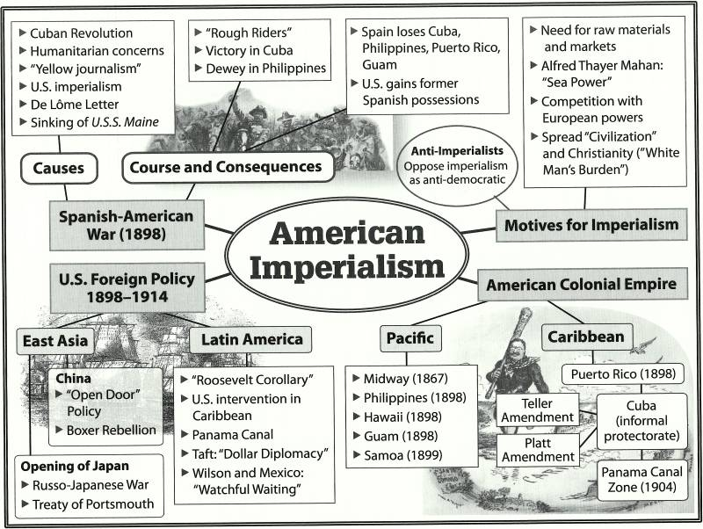

Slide 70
Spanish-American War April-August 1898
Origins;
Humanitarian concerns- moral obligation to help Cubans
Yellow Journalism(sensationalizing news)
Economic Interests- American investments exceeded $50 million
Imperial interests- ability to expand and obtain strategic possessions; Ostend Manifesto- 1854 US minister to Spain wrote report to encourage purchasing Cuba from Spain and using it as a slave colony
Jose Marti organized a rebellion while living in the US- in 1895 he declared Cuban independence and returned to Cuba where he was killed one month later

Slide 71
Spanish-American War April-August 1898
Triggering events;
De Lome letter- Feb 9,1898; Enrique Dupuy de Lome, Spanish Ambassador to U.S. wrote to Don José Canalejas, the Foreign Minister of Spain, calling President William McKinley weak- letter was published by in Hearst Press
Explosion of USS Maine- Feb 15, 1898-Havana harbor, Cuba

Slide 72
Spanish-American War April-August 1898
Course and Consequences:
Florida had embarkment camps at Tampa, Miami, and Jacksonville
Commodore George Dewey defeated Spanish fleet in Manilla Bay
Teddy Roosevelt resigned his post as assistant secretary of the Navy and gathered a group of volunteers known as the rough riders (the first volunteer US cavalry units). They led a famous charge up San Juan Hill in Cuba which helped the arm capture Santiago the capital.
Teller Amendment (April 1898)- U.S. would not annex Cuba
Platt Amendment (1901)- stated conditions for withdrawal of US troops from Cuba;
US has access to naval bases in Cuba
Cuba will not borrow any amounts from foreign countries that they could not repay
Gave US rights to intervene in Cuban affairs at any time
US annexed Puerto Rico, Guam,and The Philippines
Hawaii annexed in 1898

Slide 73
Imperialism
Imperialism- one countries rule over another
Logic of Imperialism;
-need for raw materials and markets for American Industries
-New Technological capabilities- made it possible to colonize others
-Importance of Naval Power; Captain Alfred Thayer Mahan book, The influence of sea power upon history- believed sea power made a nation truly great. He argued the US needed a large merchant fleet and overseas colonies. Suggested a canal thru Panama, annex colonies in the Pacific and Caribbean to serve as naval bases, and develop greater trade with East Asia.
-Competition with European powers; if we don’t colonize lands, they will
-The “White Man’s Burden”-superior in superiority of Anglo-Saxons

Slide 74
Imperialism
Anti-Imperialist Argument:
Its immoral and goes against basic values of American Democracy
Negative economic repercussions; colonies could become cheap source of labor
Others felt this could lead to future armed conflict with other imperial powers

Slide 75
American Foreign Policy 1898-1914
Roosevelt Corollary to the Monroe Doctrine; (1823 President Monroe announced that the US would not allow any European Powers to establish new colonies in the Western Hemisphere. In 1904 when Dominican Republic owed debts to European countries Roosevelt did not let those countries use force to collect. US collected and acted as “international police power”
Roosevelt’s motto was “walk softly and carry a big stick” this attitude in the Caribbean became known as the “Big Stick Policy”
Dollar Diplomacy- Taft’s use of American investments to promote American Foreign policy in the Caribbean
Open Door Policy (1899)- U.S. Secretary of State John Hay- declared equal trading rights throughout China
Boxer Rebellion- violent anti-foreign, anti-colonial and anti-Christian uprising that took place in China between 1899 and 1901. Western powers and Japan organized a multinational force to crush the rebellion. formally ended with the signing of the Boxer Protocol on September 7, 1901

Slide 76
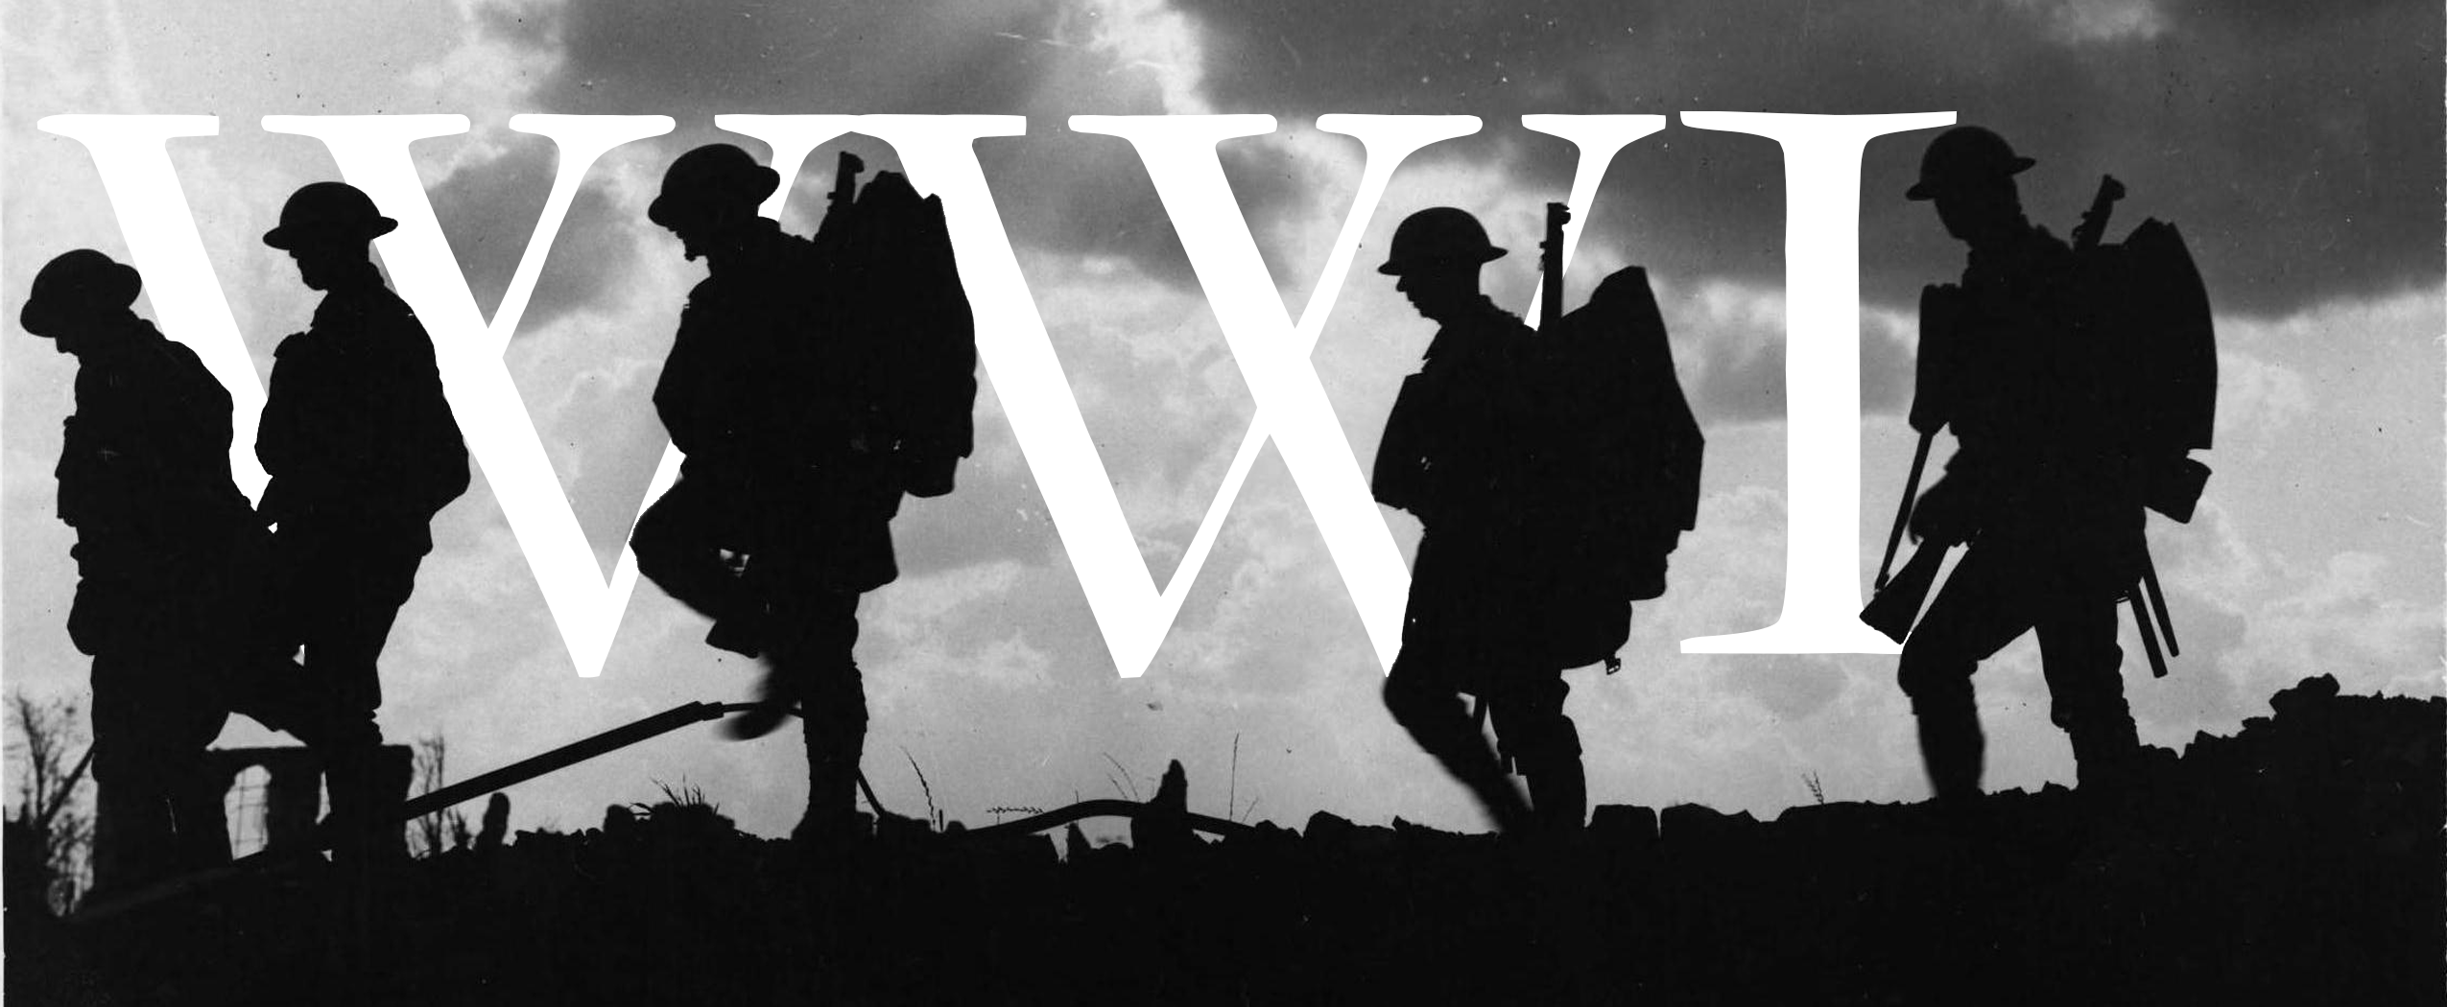

Slide 77
World War I (not the big one)
Timeline
Archduke Ferdinand assassinated in Sarajevo 1914
Austria-Hungary declares war on Serbia
Germany backs Austria-Hungary and Russia backs Serbia- Alliance system
German submarines aggressively attack allied ships
Lusitania sunk 1915- passenger ship- 128 Americans on board; made it harder to keep U.S. out of war.
Convoy system helps significantly reduce shipping losses
Germany declares unlimited submarine warfare on US-1917
Zimmerman Telegram- march 1917; Arthur Zimmerman German Foreign minister sends telegraph to Mexico telling them to join Germany and they will get Texas, New Mexico, and Arizona back after war
U.S. enters war April 1917
Russia drops out of war November 1917- Bolshevik Revolution (Lenin becomes leader)
American troops begin arriving June 1918- 10,000 a day (AEF)
Germans surrender November 1918
Treaty of Versailles signed June 1919

Slide 78
Origins of the war
Origins of the War:
Militarism
Alliance system
Nationalism
Imperialism
Assassination of Archduke Franz Ferdinand (1914) (He was the Prince of Austria-Hungary)
Economic rivalries and imperialism
Causes of U.S. involvement
German atrocities and Allied Propaganda; German invasion of Belgium and treatment of their people
Sinking of Lusitania – May 7, 1915 more than 1000 passengers killed- 128 Americans, 94 children
Germany declares unlimited submarine warfare 1917- German leaders thought they could defeat Britain and France before U.S. could enter and be effective
Zimmerman Telegram- march 1917; Arthur Zimmerman German Foreign minister sends telegraph to Mexico telling them to join Germany and they will get Texas, New Mexico, and Arizona back after war
American Idealism- making the world safe for democracy
Germany sinks several U.S. unarmed merchant ships-March 1917
Wilson Addresses congress and obtains declaration of War
April 1917- U.S. enters war

Slide 79
Fighting in Europe
Trench Warfare- new style of fighting
Naval Blockade- British blocked north Sea; Germans couldn’t defeat British Navy so they used submarines to prevent ships from bringing supplies to Great Britain
Tanks- were new and not very effective
Airplanes- mostly used for reconnaissance
Submarines- used in WW1 very effective by Germans; U-boats
Convoy system- used to protect ships in Atlantic- had naval and air escorts
Larger ships with longer range guns
Machine Guns
Russia drops out of war November 1917- Bolshevik Revolution (Lenin becomes leader)
Germany concentrates all their efforts on the western front- launch massive offensive
Central Powers- Germany Austria-Hungary, and Ottoman Turkey;
Allied Powers- Britain, France, and Russia, and Italy (after they changed sides)

Slide 80
America prepares for War
Mobilization- Getting the country ready for war. AEF (American Expeditionary force) under command of General Pershing
Selective Service Act(1917)- conscription (the draft); 10 million men registered; 3 million men were drafted; another 2 million volunteered
Committee of Public Information- created posters, printed pamphlets; propaganda- one-sided information designed to persuade listeners
Espionage Act 1917; Censorship of mail; punish those who interfere with the draft. Supreme court in Schenck v. U.S. ruled that free speech could be restricted whenever a clear and present danger was evident.
Sedition Act 1918; was an amendment to the Espionage Act- prohibited use of disloyal language about the Gov’t, the flag or the Constitution
War Bonds also known as Liberty Bonds- patriotic act to buy bonds
War Industries Board- coordinated Americas wartime manufacturing
Schenck v. U.S.- Charles Schenck arrested for mailing leaflets encouraging young men to avoid the draft. Supreme court ruled that freedom of speech can be restricted when a “clear and present danger is evident”- Justice Oliver Wendell Holmes Jr.

Slide 81
Homefront
Propaganda- information(misleading) used to promote a political agenda)
Conscientious Objector- a person who objects to serving in the military, generally due to religious reasons
Great Migration- Thousands of African Americans left south to move north for jobs in factories and Midwest for jobs on farms
Wilson’s Fourteen Points: Jan 1918 speech to congress;
called for new diplomacy to replace militarism
Creation of League of Nations
Freedom of the seas
Reduced armaments
Removal of all trade barriers- Establish equal trade among all nations
Evacuation of all occupied territories
Turkey to become a sovereign nation
New Baltic states formed

Slide 82
Treaty of Versailles (June 28, 1919)
Treaty Harsh on Germany
Germans forced to sign “war guilt” clause accepting blame for starting war- had to pay massive reparations to allies
Germany looses territory to France and Poland, and looses its colonies
U.S. rejects Treaty of Versailles and does not join League of Nations- signed separate peace treaty with Germany 1921
League of Nations; An organization of nations that would defend each other against aggressors- Wilson returned home from Versailles and needed 2/3 of senate to ratify the treaty. 1918 Republicans gained control of senate; They rejected the treaty

Slide 83
Experience of Minorities
Women:
January 1917 Jeanette Rankin became first woman in congress
German Americans:
Faced prejudice in America; ¼ population was from German descent
American Indians:
Citizenship Act 1919- Indians who served in armed forces could become U.S. citizens
Jewish Americans:
Faced prejudice- Formed Anti-Defamation League to oppose anti-Semitism and religious prejudice
African Americans:
First two Americans to receive French Croix De Guerre for heroism were African Americans- Henry Johnson & Needham Roberts
Asian Americans:
Those who served could become naturalized citizens
Immigration Act of 1917- barred any further Japanese or Chinese immigration

Slide 84
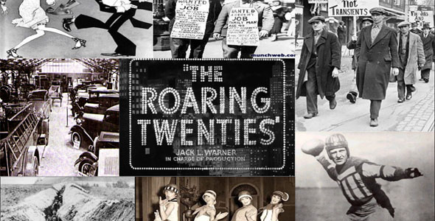

Slide 86
The Roaring Twenties
The Roaring Twenties was the period in Western society and Western culture that occurred during and around the 1920s. It was a period of sustained economic prosperity with a distinctive cultural edge in the United States and Western Europe, particularly in major cities such as Berlin, Chicago, London, Los Angeles, New York City, Paris, and Sydney.
A boom refers to a period of increased commercial activity within either a business, market, industry or economy as a whole. For an individual company, a boom means rapid and significant sales growth, while a boom for a country is marked by significant GDP growth.

Slide 87
Demobilization
Nation at war returns to state of peace
Soldiers retire from active duty
Economic production reverts back to civilian purposes

Slide 88
Warren Harding (29th president; won 1920 election; inaugurated March 1921)
Return to normalcy (his campaign slogan)
Higher Tariffs; Fordney-McCumber Act (1922) – foreign goods taxed on average 38.5% of their value
Minimal Government interference on Business; did not overturn any existing laws regulating business- failed to enforce them
Immigration restrictions;
Emergency Quota Act 1921- capped immigrants entering U.S. at 350,000; each country assigned a max number of immigrants based on the total number of these living in the U.S. in 1910
Foreign Policy; reduce the threat of war- Disarmament
Washington Naval Conference; Britain, Japan, & U.S. agreed to stop building battleships and reduce existing ships
Four- Power Treaty (December 13,1921); U.S., Britain, Japan, & France agree to respect their property rights in the Pacific- settle any disputes among the four countries
Dawes Plan-(1924) Charles Dawes (Banker) – had private businessmen lend money to Germany ($200 million) which they used to pay reparations to Britain and France- they used this money to pay back loans to U.S.
Teapot Dome Scandal(1921-1922); Sec. of Interior had oil rich lands in Tea-pot Dome Wyoming (reserved for the Navy), transferred to his department so he could lease them to oil companies in return for bribes
Harding died of Heart Attack in 1923

Slide 89
Calvin Coolidge (30th president)- motto; the business of America is business
He rarely spoke in public; became known as Silent Cal
Re-elected in 1924 (slogan Coolidge Prosperity)
Immigration Act of 1924; lowered total number of immigrants to 150,000 (2% of foreign born residents living in U.S. in 1890); drastically reduced immigrants from southern and eastern Europe
The National Origins Act of 1924 was a component of the Immigration Act of 1924 that established a quota system for determining how many immigrants could enter the United States, restricted by country of origin. Since Asian immigrants were ineligible for citizenship, no Asians could immigrate to the US
Foreign Policy; more disarmament
Kellogg-Briand Act (1927); 15 nations signed agreement
April 1927 French foreign minister Aristide Briand wrote to American Secretary of State Frank Kellogg that France was ready to enter a treaty to outlaw war. Commonly known as Kellogg-Briand Pact
Kellogg won Nobel Peace prize

Slide 90
Herbert Hoover; 31st President (1923-1929)
Secretary of Commerce under Harding & Coolidge
Director of U.S. Food Admin during WW1

Slide 91
Economic Boom of 1920’s
Economic boom; wages increased, profits and production soared
Efficiency in manufacturing; 1914 Henry Ford introduced assembly line- automobiles become very affordable
Rise of Automobile- 1920- 8 million cars on road; helped steel, rubber, and glass industries
Other new industries; household appliances became available for first time- vacuum cleaner, refrigerator
New marketing practices; Advertising in newspapers and magazines, & business sponsored radio programs;
Stocks; shares of a company (ownership)- during the 1920’s people were putting their profits in the stock market; as demand for stocks rose, their prices also rose
Margin buying- paying 10% for a stock and then paying off the balance when you sell the stock- very risky
Installment Buying- buying an item without having enough money to pay for it. Paying in pieces(usually monthly)- sometimes costs more in total due to interest charges

Slide 92
Traditional Values of the 1920’s
People felt greater sense of freedom and power; cars gave them more independence, also more people were being educated: some people still believed in the traditional values
Prohibition: Temperance Movement; movement to ban all alcohol- religious movement
18th Amendment ratified Jan 16, 1919- Prohibition. took one year to take effect
Volstead Act- (1919) defined what Alcoholic beverages were-referred to as “intoxicating liquors” included beer and wine
The Caribbean became main source of bootlegging for Florida during prohibition
Scopes Trial: John Scopes, high school teacher in Tennessee was arrested for teaching evolution
Christian fundamentalists believed that the bible should be taken literally- they opposed evolution
New Values:
Women- 19th Amendment (1920) gave women the right to vote
Flappers; woman who wore red lipstick, short dresses, and liked to go out and party
Margret Sanger- 1921 started the American Birth Control League, which later became Planned Parenthood
June 19, 1915- Zena B. Dreier became first woman to vote in local election

Slide 93
Red Scare
Bolsheviks (Russian Communists) Seized power Nov. 1917 (Vladimir Lenin)- Russians then dropped out of war
Success of Bolsheviks, communist attempts in central Europe, and labor strikes across the U.S. made Americans fearful of communist revolution in U.S.- this became known as the- Red Scare
Sacco & Vanzetti; Italian immigrants (anarchists) accused of murder during a robbery- evidence was unclear, however they were convicted; executed in 1927
Palmer Raids (Jan 1920); J. Edgar Hoover organized directed raids in 30 cities and arrested about 6000 people, mostly Russian and German born
Communism- a political theory where everything is owned by the people. Developed by Karl Marx- people work and are paid according to their abilities and needs
Nativism- The belief that you are superior because you were born in the country you live in
Anarchism- a political philosophy that advocates self-governed societies based on voluntary institutions. These are often described as stateless societies.

Slide 94
African Americans/Civil Rights
Booker T. Washington (1856-1915); most famous black man of his generation. He was born into slavery, taught himself how to read. He believed that blacks should achieve a vocational skill rather than demand immediate social equality
W.E.B. Du Bois (1868-1963); believed that blacks should have full social equality. He disagreed with Washington.
1909-1910 Du Bois joined with white progressives in NY and formed the NAACP- National Association for the Advancement of Colored People
Marcus Garvey; established Universal Negro Improvement Association- he opposed cooperation with whites in organizations like NAACP. Encouraged blacks to form their own business’s and act independently. In 1923 was convicted of mail fraud; deported to Jamaica in 1927
Harlem Renaissance:
1920’s approximately 15 million blacks were living in America; greatest number were in Harlem (NY). Langston Hughes- most celebrated poet of his time; Started their own newspapers, magazines. Black writers began writing about how blacks should not tolerate the old ways of subservience; began referring to those blacks who still did as “Uncle Toms”
Jazz Age-1920’s and 30’s – jazz gained popularity
Communism- a political theory derived from Karl Marx- all property is publiclly owned and people are rewarded based on their ability and needs.
Anarchists- believe in no central authority- people free to do what they want
Ku Klux Klan- second resurgence in 1915; peaked in 1924 with almost 5,000,000 members

Slide 95
Florida in the 1920’s
Rosewood- (near Gainesville FL); one of the worst acts of racism ever in U.S.
Jan 7, 1923 a white mob burned down the entire town
State Gov’t awarded the survivors and descendants $1.5 million in damages- first time victims of racial violence were compensated by a state
Florida led the country in lynching’s during this time
Florida land boom. Florida became destination for vacationers and a land speculators paradise
Between 1923-25 Florida eliminated its inheritance and income taxes- brought over 300,000 people
1926- Hurricane hit- (“great Miami”) hurricane- thrusts Florida into an economic depression
1928- another hurricane hits (Okeechobee Hurricane)- ends Florida land boom

Slide 96
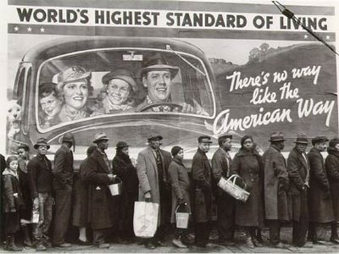
The Great Depression (1929-1939)

Slide 97
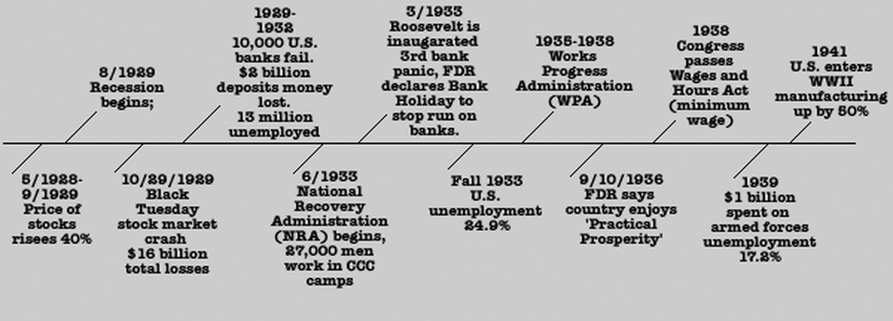

Slide 98
Franklin Delano Roosevelt
Franklin Delano Roosevelt Sr.-
Referred to as FDR, 32nd President from 1933 until death in 1945. Democrat, won a record four presidential elections. Directed federal government during most of Great Depression, implementing New Deal in response to worst economic crisis in U.S. history
1932 presidential election, Roosevelt defeated Republican President Herbert Hoover in a landslide
20th Amendment- (1933) changed terms of president and Vice president from March 4 to January 20
21st Amendment (1933) repealed prohibition

Slide 99
The Great Depression
The Great Depression- severe worldwide economic depression that took place mostly during the 1930s, beginning in the United States
Smoot Hawley-Tariff (1930)- raised import duties, adding considerable strain to the international economic climate of the Great Depression. Raised U.S. tariffs on over 20,000 imported goods.
Gross national product (GNP) is a broad measure of a nation's total economic activity. GNP is the value of all finished goods and services produced in a country in one year by its nationals.
The Bonus Army were the 43,000 marchers—17,000 U.S. World War I veterans, families, and others—gathered in Washington, D.C. summer of 1932 to demand cash-payment redemption of their service certificates. Organizers called the demonstrators the "Bonus Expeditionary Force", to echo the name of World War I's American Expeditionary Forces,

Slide 100
Causes of Great Depression
Causes:
Weakness in the economy
Overproduction/ under consumption; 1920’s rapid expansion- items like cars, refrigerators, & radios were overproduced. High Tariffs restricted international trade; Smoot-Hawley Tariff (1930)- raised customs duties on thousands of goods- contributed to reduction in U.S. trade by more than half
Buying stocks on margin; borrowing money from a broker to purchase stock. You can think of it as a loan from your brokerage house;
drove prices up created a frenzy of buying in the stock market
Stock market crash of 1929; Black Tuesday (October 29); the panic-selling of massive amounts of stocks and shares. triggers chain reaction as prices collapsed
The Dust Bowl(1930-1936)- a period of severe dust storms that greatly damaged the ecology and agriculture of the U.S. and Canadian prairies during the 1930s; severe drought and a failure to apply dryland farming methods to prevent wind erosion caused the phenomenon.
Herbert Hoover believed in laissez-faire economics-(belief that economies and businesses function best when there is no interference by the government) he didn’t interfere directly in the economy, eventually tried, but it was too little too late
Speculation- investment in stocks, in the hope of gain but with the risk of loss.

Slide 101
The First New Deal (1933-1935)
Roosevelt took office in 1933 at height of the depression; problems facing nation:
New Deal established the principle that the Government bears the ultimate responsibility for the smooth running of the American economy; He described this in terms of three goals- Recovery, Relief, Reform
First New Deal- 1933-1935;
Bank Holliday- closed all banks; only permitted to open after government inspected
FDIC (Federal Deposit Insurance Corporation) - insured bank deposits (1933)
SEC (Securities and Exchange Commission) -1934; oversees the stock market
CCC (Civilian Conservation Corps)- 1933; gave outdoor jobs to young men- they were required to send most of their pay home; supervised by Army officers
Tennessee Valley Authority-(TVA) 1933; built 21 dams along the Tennessee river (the area was impoverished and many areas lacked electricity and running water; dams controlled floods and produced hydroelectricity
AAA (Agriculture Adjustment Act) – provide low interest loans for farmers facing foreclosure
NRA (National recovery Act)- designed to help industries by increasing prices and reducing wasteful competition

Slide 102
Second New Deal: (1935)
Second New Deal- term used by commentators and historians to characterize the second stage, 1935–36, of the New Deal programs of President Franklin D. Roosevelt
Works Progress Administration (WPA) (1935)- created new public works projects (building public schools, courthouses, bridges) ; increased employment- gave over 8,000,000 people jobs
Social Security Act (1935)- most important law passed in New Deal:
Provided unemployment insurance- workers received money paid out of tax on employer payrolls
Retirement benefits- workers receive monthly payments after retirement, paid by a special tax on their wages and contributions from their employers. Spouses and children received death benefits as well
Disabled and orphans eligible to receive special grants from Social Security
National Labor Relations Act (1935)- Wagner Act; gave workers the right to form unions and bargain collectively. Also, they could file grievances with the National Labor Relations Board
Fair Labor Standards Act (1938)- set maximum working hours and a minimum wage; also prohibited child labor in factories

Slide 103
Pros and Cons of New Deal Legislation
New Deal positives;
Reduced unemployment
Completed valuable public works projects
Social security
SEC
Increased power of Labor Unions- increased min wage and reduced max hours worked
Established principle that government should oversee economy and protect citizens
Showed that increased government spending, lower taxes, and inflation could fight unemployment
New Deal negatives;
Increased national debt
Increased taxes
Increased size of federal bureaucracy

Slide 104
Roosevelt’s Court Packing plan
In response to Supreme court ruling against some of FDR’s first new deal legislation, he proposed-
Court Packing Plan; Supreme court ruled National Industrial Reconstruction Act and Agricultural Adjustment Act were unconstitutional- he was worried how they would rule on rest of new deal legislation so he proposed to congress the following; the president should be allowed to appoint a new justice for each one that did not retire at age 70. It did not pass, however all legislation in the second new deal was upheld

Slide 105
Amendments
20th amendment- (ratified 1933) changes the inauguration date of president from March 4 to January 20.
21st amendment- (ratified 1933)- repealed prohobition

Slide 106
Florida- Great Depression
1931- Legalized gambling in hopes of improving the economy
1933-1940- sewers, roads, and schools were built by the WPR (works progress administration); CCC (civilian conservation corps)- work camps were here; the also rebuilt 100 miles of the Florida east coast RR- which had been damaged by1935 Hurricane
1938- State legislatures ended the Poll tax.

Slide 107
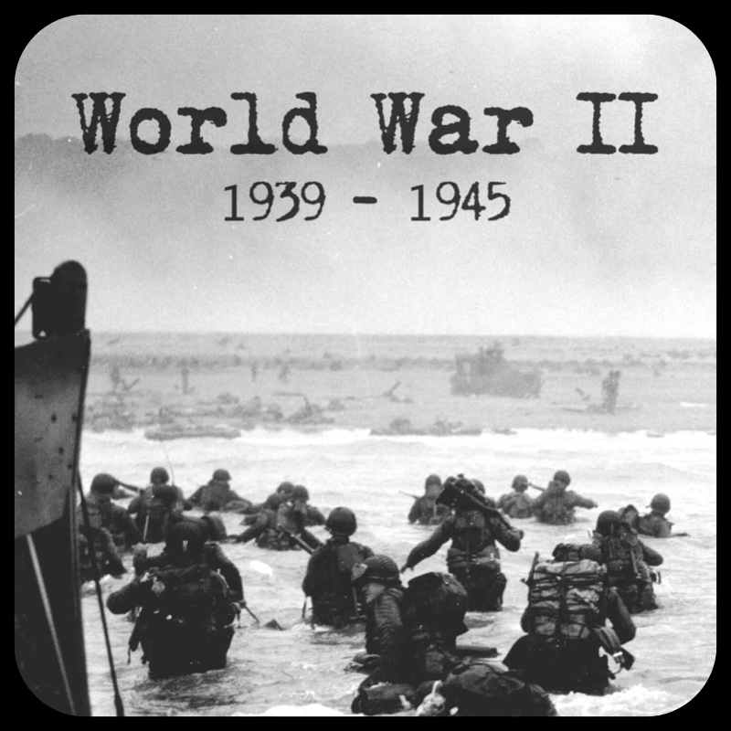
World War II (the big one)

Slide 108
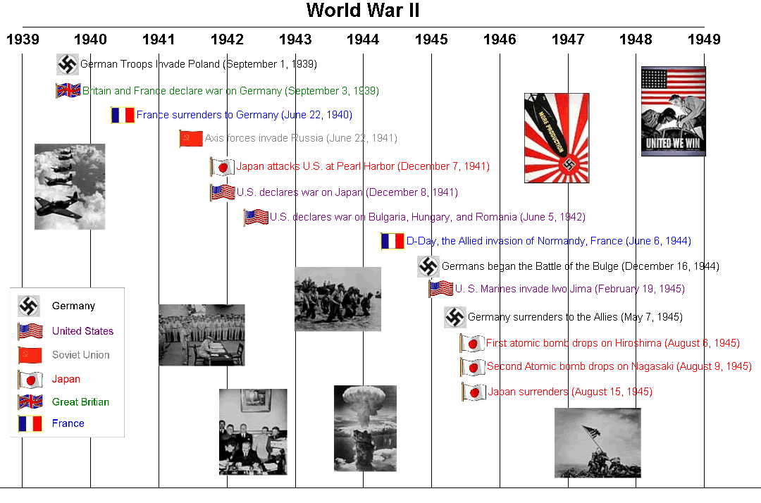

Slide 109
Origins of WWII In Europe
Rise of Dictatorships in Europe
New set of beliefs (known as fascism- named after Italian party that first introduced it) due to;
The harsh violence of WWI
Benito Mussolini- first fascist dictator in Europe
In Germany Nazi (National Socialist) party founded after WWI – leader Adolf Hitler;
Hitler had special hatred for the Jews- he blamed them for the German defeat in WWI
Nazi party taught doctrine of absolute obedience to party leader- Fuhrer
Was a social Darwinist
Was determined to use German technological superiority and military strength to take over Europe- Nazis glorified violence
Hitler wrote Mein Kampf (my struggle) 1925-1926- outlines Nazi Philosophy

Slide 110
Origins of WWII In Europe
Failure of the League of Nations;
U.S. and Soviets never join
Germany and Japan leave in 1933
1936 Hitler sends troops into Rhineland (violation of the Treaty of Versailles) –league can do nothing about it
League also unable to stop Japan from invading Manchuria (1931)
Failure of Appeasement
Appeasement- policy of giving in to the demands of a potential enemy
Munich conference Sept. 1938- British and French leaders agree to give Germany western part of Czechoslovakia (Sudetenland); this encouraged Hitler to make more demands- he felt Britain and France were weak
October 1938- Germans annex Sudetenland (Western Czechoslovakia)
1939- Germans occupy Prague

Slide 111
World War II Begins
Nazi-Soviet Pact (August 1939)- Hitler and Stalin agree to divide Poland
September 1939- Germany invades Poland from West- Soviets invade Poland from East
Britain and France responded by declaring war on Germany
Blitzkrieg (lightning warfare)- New tactic used by Germany- using airplanes, tanks, motorized troop carriers and communications by radio- because the speed of the German advance- called Blitzkrieg
April 1940- Germans invade Denmark and Norway
May 1940- Germans attack Netherlands, Belgium, Luxemburg, and France
June 1940- French surrender
Battle of Britain July-Oct 1940: Hitler uses his air force (Luftwaffe) to bomb the British
British Royal Air force shoots down many German Planes- they also use radar (new invention) to detect arriving German Planes- big moral victory for Great Britain

Slide 112
America Maintains Partial Neutrality
Same year congress passed acts prohibiting new loans to Britain and France since they stopped paying their debts from WWI
Neutrality Acts (1935,37,39)- To keep the US out of future wars
Neutrality Act of 1935- prohibited Americans from sending “arms, ammunition, and implements of war” to foreign nations that were at war
Neutrality Act of 1936- renewed the Act of 1935 for 14 more months
Neutrality Act of 1937- extended prohibition on sale of arms to parties engaged in civil war (Spain)- also prohibited Americans from traveling on ships of Nations at war
Permitted sale of non-military goods to countries at war on a “cash-and-carry” basis
Neutrality Act of 1939- prohibited Americans from entering war zones, also renewed “cash- and-carry” provisions of the 1937, Act allowed the United States to sell munitions, although on a “cash‐and‐carry” basis.
1940- following Germany defeat of France, congress passed first Peacetime draft- men ages 21-35 had to register
Destroyers for Basses- December 1940- Roosevelt gave 50 destroyers to British in return for leases on British bases in Canada and Caribbean
Lend-Lease Act of 1941- in one of his fireside chats (radio broadcast to the country) Roosevelt proposed America as the “arsenal of democracy” and should supply arms to the British. This act repealed parts of the Neutrality Act of 1939- Authorized U.S. to lend, lease, or sell war materials to “any country who’s defense the president deems vital to the defense of the United States”
Congress repealed the Neutrality Acts on 13 November 1941.

Slide 113
America Maintains Partial Neutrality
Four Freedoms and the Atlantic Charter:
1941 State of Union- Roosevelt told Americans that he hoped to establish a world based on Four Freedoms:
Freedom of speech and expression
Freedom of person to worship God in their own way
Freedom from want
Freedom from fear
Atlantic Charter- August 14, 1941- between Roosevelt and Winston Churchill (Prime Minister of Great Britain)- 8 points outlining peace and individual freedoms. Also discussed post war world. Laid foundation for the future United Nations
1941- U.S. troops occupied Greenland and Iceland

Slide 114
The United States enter the war
Japanese occupy Manchuria in 1931
They invaded the rest of China in 1937
June 1941- Hitler abandons pact with Stalin and invades the Soviet Union
Japan sends forces into Indochina
Roosevelt freezes Japanese assets in the United States, he offered to restore normal trade relations if Japan withdrew from Indochina and China- Japan refuses; He also put massive trade restrictions on Japan, including an oil embargo
December 7, 1941- Japan bombs Pearl Harbor
Destroyed 6 ships and 180 aircrafts
Killed 2403 and wounded another 1178
Half of those killed were aboard the USS Arizona
Four days later Germany and Italy declared war on the U.S.

Slide 115
The United States at war: The Home Front
The Draft; first peacetime draft introduced in 1940
Tuskegee Airmen- Unit of African American fighter pilots- flew more than 1500 missions in Europe
Indians; Navajo “Code talkers” Navajo language used to form secret codes in Pacific Campaign
War production Board; helped conversion from peacetime to wartime
Rationing- Using less of something to conserve so it will last longer; heating fuel, gasoline rubber
People were given ration booklets with coupons
National Labor War Board- oversaw the needs of workers
War cost over $300 billion- almost half was paid for by revenues from tax receipts. Practice of withholding taxes from workers payrolls was introduced during WWII
Executive order 9066 Feb 19, 1942- placed all people of Japanese Ancestry (living in a 100 mile wide zone along the west coast) to Internment Camps
Korematsu V. United States; Fred Korematsu (Japanese American) refused to relocate- he was arrested and convicted- Supreme Court upheld the decision- 1944
Executive Order 8802- June 25, 1941- reaffirmed that no federal agency would discriminate hiring practices on the grounds of race, creed (religion), color of national origin. Also established committee on Fair Employment Practices

Slide 116
THE HOLOCAUST
Hitler planned to reorganize Europe along racial lines; Germans would be the new ruling class- other people would be turned into slaves. Jews, Gypsies, Poles and Several other groups were to be exterminated
Holocaust- systematic slaughter of millions of Jews and other people
1935- Germany past Nuremberg Laws- deprived German Jews of citizenship, prevented them from holding jobs, and prohibited them from marrying non-Jews (black codes for Jews)
Kristallnacht;
1938 Jewish refugee assassinates German diplomat in Paris
German Gov’t uses this as an excuse to attack Jews, Synagogues, and stores in Germany
Thousands of Jews arrested and sent to concentration camps
So much broken glass fell on the street that it became known as Kristallnacht (night of broken glass)
1939 following fall of Poland- millions of Jews were rounded into Ghettos (restricted areas of Polish cities that were sealed off from the outside)
1941 when Germans advanced into Russia-special firing squads were set up to kill Jews in mass shootings
Beginning of 1942- Wannsee Conference- Nazi leaders decided on a “Final Solution”- complete extermination of all Jews in Europe- special camps were set up (concentration camps) such as Auschwitz in Southern Poland- Jews were lead to showers where they were gassed with Zyklon B (form of cyanide)- Their bodies were then burned in large ovens.
State dept. turned down an offer to ransom 70,000 Romanian Jews
A bill to admit 20,000 German Jewish children was defeated in congress
May 1939- group of German Jews sailed an ocean liner (SS St. Louis) to Cuba- they were refused, boat then sailed to Florida, but were refused by U.S. (and Canada)- They had to sail back to Europe- half of the passengers died in Germen Concentration Camps

Slide 117
The War In Europe
Two great blunders by Hitler:
1-1941- invaded the Soviet Union
2-December 1941- declared war on the U.S.
Roosevelt maintained a “Germany first strategy”
November 1942- U.S. and British troops landed on coast of Morocco and Algeria- 275,000 German troops surrendered May 1943 in Tunisia
July 1943- U.S. and British forces cross the Mediterranean Sea and land in Sicily.
Allied success in Sicily July 1943 led to the overthrow of Mussolini by his Opponents. September 1943- New anti-fascist Italian government surrenders to allies
September 9, 1943- allies launch amphibious attack on Salerno and fight with the German troops
Tehran Conference-Roosevelt, Churchill, and Stalin met at Tehran on Nov 1943; Roosevelt promised Stalin that western allies would invade France -Stalin promised to declare war on Japan once Germany surrendered
D Day; known as “operation overlord” – General Dwight D. Eisenhower placed in supreme command of allied invasion
June 6, 1944- actual D Day- massive number of allied troops land on beaches at Normandy
August 25 1944- Paris liberated
Battle of the Bulge- (The Ardennes; Belgium, Luxembourg, Germany)December 16, 1944 – end of Jan 1945 bloodiest action by U.S. Forces – allies prevailed
Hitler committed suicide April 30, 1945
German military leaders surrendered May 7-8 – known as V-E Day – “victory in Europe”
President Roosevelt died of a heart attack on April 12, 1945

Slide 118
The Pacific Theater
Fall of the Philippines
Japanese forces attacked the Philippines and General Douglas MacArthur retreated to Bataan (Peninsula near capital of Manila) – surrendered April 1942 – Japanese made the prisoners walk 80 miles “Bataan Death March” where thousands died
Coral sea and midway;
May 1942 Battle of coral sea – first time in history that aircraft carriers fought while separated by more than 100 miles of ocean
June 1942 Battle of Midway – Japanese tried to lure US Pacific fleet into trap near midway island – U.S. knew what Japan was up to because they were able to decipher part of a Japanese secret naval code and were ready for the Japanese. U.S. Admiral Chester Nimitz positioned several U.S. carriers just northeast of Midway island without detection; the Japanese began their attack on the island, and when their ships were most vulnerable American dive bombers attacked.
Japanese lost four large aircraft carriers- this battle was the turning point of the war in the Pacific.
Guadalcanal – Japanese began building an airfield there – two months after Battle of Midway, marines landed on Guadalcanal and took the island by surprise

Slide 119
The Pacific Theater
By 1943 the U.S. troops began island hopping – liberating some Pacific islands from the Japanese; April 1944, they landed in New Guinea, then in 1945, regained control of the Philippines
U.S. was preparing for a massive invasion of Japans home islands. April 1945 American forces landed in Okinawa (large island 340 miles from Japanese home islands)- Bloodiest battle of Pacific war
After German surrender in May 1945 – Soviet Union declared war on Japan and invaded Manchuria
Dawn of the Atomic Age
Albert Einstein (German, Jewish refugee) wrote a letter to Roosevelt recommending the U.S. development of the atomic bomb
Shortly after Pearl Harbor – U.S. government launched “Manhattan project” – goal was to develop an atomic bomb; physicist Robert Oppenheimer was in charge – first atomic bomb was tested in New Mexico desert July 1945
Harry Truman – became President (33rd) after FDR died April 12 1945 – He had no knowledge of the “Manhattan Project”
He selected two cities that were centers of military production as targets for the Atomic Bomb;
August 6, 1945 the first atomic bomb explodes over Hiroshima, August 9 second bomb explodes over Nagasaki; more than 100,000 people died at each location
August 15, 1945; VJ day- Japan surrenders
September 2, 1945 Japan signs surrender papers aboard the USS Missouri

Slide 120
Consequences of WWII
U.S. and Soviet Union become two super powers in command of the world
U.S. grants Philippines independence in 1946
Nuremberg Trials- Allied leaders put surviving Nazi leaders on trial for war crimes 1945-1946; Herman Goering head of the Luftwaffe (German Air force) commits suicide in his cell just before his scheduled execution
Germany was occupied by U.S., Britain, France, and Soviet Union
U.S. occupied Japan after the war
Tehran conference (Nov 28- Dec 1 1943)- Roosevelt, Stalin and Churchill met to discuss how to deal with Germany
Yalta Conference (February 1945)- Same three met again to discuss Europe’s post war reorganization- agreed to split Germany into four zones of occupation, and allow free elections in eastern Europe: Russia agreed to join war against Japan when Germany was defeated
Potsdam Conference (July 17- August 2, 1945) – Truman, Churchill (Churchill was replaced on July 26 by Clement Attlee new Prime Minister), Stalin met after Germany surrendered, to negotiate terms for the end of the war and determine postwar boarders in Europe.
Germany would be run by the four occupying powers- U.S., Britain, France, and Soviet Union
Potsdam Declaration- U.S., Britain, and China – threatened Japan with “prompt and utter destruction” if it did not immediately surrender

Slide 121
Consequences of WWII
Birth of the United Nations: organization was officially established on 24 October 1945
Atlantic Charter- August 14, 1941- policy statement drafted by U.S. and Great Britain- defined Allied goals for post world war
U.S. made sure that the Soviets joined U.N.- international peace keeping organization
Autumn 1944- Dumbarton Oaks (outside of D.C.)- leading allied powers agreed on the general structure of the United Nations, including formation of a “Security Council”
San Francisco Conference (April to June 1945)- U.S. became first nation to sign the UN charter-26 June 1945
Main aim of the charter- maintenance of peace and encouragement of friendship and cooperation among nations
UN has its own peace keeping force
All member nations belong to the general assembly
Five nations serve as permanent members of security council; U.S., Great Britain, France, Russia, and China
Mary McLeod Bethune- black civil rights leader; appointed by Truman as a delegate on interracial relations at the San Francisco conference- she was only black female from any country to attend

Slide 122
Florida During WWII
Between 1940 and 1945 federal government spent more than $98 billion in the Florida economy to further the war effort
1942- four German agents were discovered on Ponte Vedra Beach- captured by FBI tried and executed
Dozens of military bases established or expanded, personnel flooded into Florida. Many soldiers, sailors, marines, and airmen who trained or served in Florida later returned as retirees and helped fuel the postwar economic boom.
Agriculture was Florida’s primary economic contribution to the war effort
During World War II, German submarines, attacked and sank 24 civilian tankers and freighters in Florida waters. At least eight were off the coast of South Florida between February and May of 1942.

Slide 124
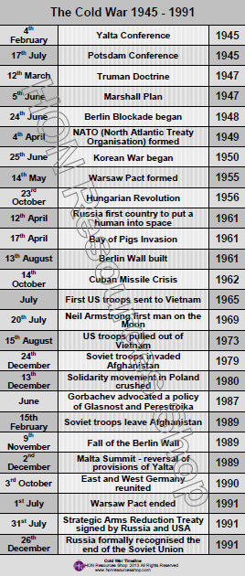

Slide 125
Social Political and economic causes of the Cold War
Cold War- Because of nuclear weapons the two super powers never confronted each other directly in open war-fare
-U.S. wanted to spread democratic free market system (capitalism)
-Soviet Union wanted to spread communism
Main Ideas of Communism
-Based on ideas of Karl Marx, as interpreted by Russian revolutionary Vladimir Lenin- main ideas of communism:
-class struggle and revolution – communist believe capitalists use wealth and power to exploit workers; workers finally rise up and overthrow ruling class in a violent revolution
-After the revolution, communist leaders establish a dictatorship to educate the people in ideas of communism
-Production is taken over by the state
-Unscientific religious beliefs are condemned
-Private property is eliminated
Soviet Communism
-In practice was a ruthless dictatorship
-Joseph Stalin succeeded Lenin- he murdered political opponents or sent them to gulags- (concentration type camps in Siberia)

Slide 126
The Cold War begins in Europe
U.S. war deaths- about 400,000; Soviets- exceeded 23 million
Post-war plans at Yalta Conference (February 1945):
Big Three (Roosevelt, Stalin, Churchill) laid plans for post war reconstruction of Europe
Germany should be divided into four separate zones
Confirmed structure of United Nations (which had been negotiated at Dumbarton Oaks Conference five months earlier)
Stalin gave plead to have free elections in Poland- he lied
The Potsdam Conference (August 1945)
Roosevelt died April 1945- just before Germany surrendered
Truman replaced Roosevelt at Postdam; They all met to decide treatment of Germany and Final campaign against Japan and future of Europe
Soviets point of view: Stalin believed they should control Eastern Europe
Americans point of view: Stalin promised free elections in Poland and should keep his word
Truman believed other European Nations wanted Democracy
Iron Curtain falls on Eastern Europe
Eastern European Governments became Satellites (dependent states) of the Soviet Union
Truman responds with Containment Policy

Slide 127
The Cold War begins in Europe
Truman Doctrine (1947)
Resulted from Greek and Turkish Government being threatened by Communist rebels
Truman proposed to congress that U.S. should provide financial assistance and military advice; he promised American support to any free people fighting communism; This was known as the Truman Doctrine
The Marshall Plan (1948)
Secretary of state General George E Marshall proposed the economic aid ($12 billion) be given to the countries of War-torn Europe
Division of Germany Berlin Blockade and Berlin Airlift:
May 1948 -French, British, and U.S. merged their zones of occupation in Germany into a single State- Federal Republic of Germany (AKA West Germany)
Soviets reacted to this by announcing a Blockade of West Berlin; closed all highways and railroad links to the city from the west
Allies began a massive airlift to feed and supply the city- Berlin Airlift
Within a year the Berlin Blockade was lifted
Soviets turned their occupation zone into independent Nation- German Democratic Republic (AKA East Germany)
NATO and the Warsaw Pact
U.S., Canada and Ten Western Europe nations formed the North Atlantic Treaty Organization in 1949; each member pledged to defend every other member if attacked. 1955 West Germany joined
Soviets responded with the Warsaw Pact- an alliance with its Eastern European satellites; used by Soviet Union to justify intervening in Eastern European affairs.

Slide 128
Containment in Asia
In China 1949 Mao Zedong (communist) overthrew Chiang Kai-shek(Nationalists)
Mainland China became worlds most populated communist state
The Korean War (1950-1953)
Korea was divided at the 38th parallel at end of WWII- North Korea and South Korea; Soviet forces occupied the North and U.S. forces occupied the South
1950 North Korea invaded South Korea
Truman sent troops, with authorization from United Nations Security Council: U.N. had invited member nations to assist South Korea
Course of War: Truman sent General Douglass MacArthur to command American forces
Forces landed at Inchon Beach, north of North Korean Army
North Koreans retreated; MacArthur marched into N. Korea near China border- large Chinese group entered war and forced MacArthur force to retreat South towards 38th parallel
MacArthur wanted to pursue war vigorously; Truman didn’t totally agree and MacArthur criticized President publicly; Truman removed MacArthur from his command
Armistice was signed in 1953 at Panmunjom- Village on the demilitarized zone

Slide 129
Cold War: Home Front
Loyalty Review Boards- created by Truman to conduct investigation of government employees suspected of “Un American Activities” such as membership in the American Communist Party.
Alger Hiss- was an official in the State Department and a Spy for the Soviet Union
1950- Julius and Ethel Rosenberg were charged with furnishing atomic secrets to the Soviets- They were tried and executed
McCarthyism- anti-communist hysteria, continued throughout the early 1950s; Feb 1950 Joseph McCarthy (Senator from Wisconsin) announced that he had a list of communist spies who had infiltrated the U.S. State Department; Democrats investigated and determined he was a fraud and a hoax; Republicans backed him
In 1953 McCarthy accused the U.S. Army of sheltering Communists. U.S. Army accused him of using improper influence to have a friend promoted. Hearing were held on TV; when McCarthy could not provide any evidence for his accusations, he was condemned

Slide 130
Cold War continues under Eisenhower and Kennedy
Eisenhower gave aid to the French who were fighting communism leaning Vietnamese in Indochina
Eisenhower Doctrine- 1956 he prevented Britain, Israel, and France from defeating Egypt and taking over the Suez Canal
1957 he announced the U.S. could be “prepared to use force to counter any aggression from any country controlled by International Communism. This containment policy to the Middle East became known as the Eisenhower Doctrine
Sputnik- 1957 Soviets launched first man made satellite into space
Nikita Krushchev became leader of Soviet Union after Stalin’s death in 1953
Cuba; 1959- Fidel Castro overthrew Cuban dictator Batista; Castro promised to establish a democracy, but he set up a Communist dictatorship.
Kennedy and containment in Latin America;
Bay of Pigs invasion in April 1961; 1400 CIA trained Cuban exiles invaded Cuba landing at the Bay of Pigs- They were defeated.
Cuban Missile Crisis- October 1962; U.S. discovered that the Cubans were secretly trying to build bases for Soviet Nuclear Missiles. Kennedy imposed a Naval blockade and threatened to invade if the missiles were not withdrawn. Khrushchev agreed to withdraw missiles if the U.S. would not invade Cuba and withdraw its own missiles from Turkey
The Berlin Wall- 1961 Khrushchev ordered construction of the Berlin Wall- separating East and West Germany. Purpose was the prevent East Germans from escaping through to Berlin and the West..

Slide 131
Cold War continues under Eisenhower and Kennedy
Florida;
1947- Everglades National park created
1949 U.S. Air Force acquired Cape Canaveral
President Dwight D. Eisenhower established NASA in 1958
NASA-National Aeronautics and Space Administration
1958 NASA was formed and U.S. entered the Space Race
1963 NASA acquired 90,000 acres on merit and Island which became the Kennedy Space Center

Slide 132
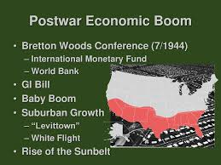
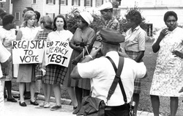
Postwar Prosperity and civil rights

Slide 133
Postwar prosperity & Civil Rights
Demobilization; ending military operations, halting wartime production and retiring troops from active service
GI Bill of Rights; 1944 A/K/A Servicemen’s readjustment Act
GI- government issued
Bill gave special benefits to veterans; unemployment payments, low rate mortgages, low interest business loans, and money to pursue further education
Baby Boom; many war veterans quickly married and had children leading to a surge in the birth rate- this was known as the Baby Boom(decade and a half following WWII (the big one)
Gross National Product (GNP); the goods and services produced in one year by all Americans. This number doubled from 1945-1960. Income rose 59% from 1950-1962. Unemployment remained low (about 4%)
22nd Amendment- Limits the presidents term to two terms- proposed 1947, ratified 1951
Bretton Woods Conference (July 1–22, 1944) - gathering of 730 delegates from all 44 Allied nations to regulate the international monetary systems

Slide 134
Dwight Eisenhower (34th President 1953-1961)
World War II, served as Supreme Commander of the Allied Expeditionary Forces in Europe. Was responsible for planning and supervising the invasion of North Africa in Operation Torch in 1942–43 and the successful invasion of France and Germany in 1944–45 from the Western Front.
After the Soviet Union launched Sputnik in 1957, Eisenhower authorized the establishment of NASA (1958), which led to the Space Race
-Suburbs- residential communities on the outskirts of cities
-1956 congress passed the Federal Highway Act, which led to construction of the Interstate Highway System- this contributed to the migration of the middle class of the Suburbs
Levittown (NY)- first truly mass-produced suburb and is widely regarded as the archetype for postwar suburbs throughout the country

Slide 135
Martin Luther King, Jr.
Dr. Martin Luther King Jr.- Baptist Minister- believed in passive resistance
1955, originally elected to lead the Montgomery Improvement Organization
December 1964, Dr. King won Nobel Peace Prize
-Led the 1955 Montgomery bus boycott and in 1957 became the first president of the Southern Christian Leadership Conference (SCLC
-King, representing the SCLC, was among the leaders of the "Big Six" civil rights organizations who were instrumental in the organization of the March on Washington for Jobs and Freedom, which took place on August 28, 1963.
He Gave His Famous “I Have A Dream” Speech
- Letter from Birmingham Jail - calls on the movement to pursue legal channels for social change. King argues that the crisis of racism is too urgent, and the current system too entrenched: "We know through painful experience that freedom is never voluntarily given by the oppressor; it must be demanded by the oppressed." He points out that the Boston Tea Party, a celebrated act of rebellion in the American colonies, was illegal civil disobedience, and that, conversely, "everything Adolf Hitler did in Germany was 'legal'." King also expresses his frustration with white moderates and clergymen too timid to oppose an unjust system:
King was fatally shot by James Earl Ray at 6:01 p.m., April 4, 1968

Slide 136
Civil Rights
NAACP and the National Urban League- both founded in New York City in first decade of 20th century
NAACP-formed in 1909- mission "to ensure the political, educational, social, and economic equality of rights of all persons and to eliminate race-based discrimination.
Social Activism- efforts to promote Political and Social change through direct action
Congress of Racial Equality (CORE)- founded in 1940 by James Farmers and other- Influenced by Gandhi’s campaign against British in India; CORE members used non-violent means to fight racism
Brown v. Board of Education of Topeka, Kansas 1954
Beginning in the 1930s, Black lawyers at the NAACP began challenging the “Separate but Equal” doctrine in public education
1950s NAACP challenged “Separate but Equal” policy itself, Linda Brown ( a school girl in Topeka)- father sued the school board because she was forced to attend an all-black school, when an all-white school was closer to her home.
1953 NAACP appealed her case to the U.S. Supreme Court; Thurgood Marshall (NAACP Lawyer) argued that every system of segregated education sends black children a psychological message that they were not “good enough” to be taught with whites
Thurgood Marshall- First black supreme court justice
Montgomery Bus Boycott- 1955 to 1956 in response to Rosa Parks (Dec. 1955) not moving(her Lazy ass) to the back of a city bus for a white passenger; Parks and others sued in Federal Court claiming segregation of Public buses was unconstitutional; June 1956 court ruled in her favor, five months later U.S. Supreme Court refused to review the decision, upholding it

Slide 137
Civil Rights
Southern Christian Leadership Council (SCLC)- formed by King, Ralph Abernathy, and other African American Ministers- goal was to fight for racial equality using nonviolent means
Social Activism- efforts to promote Political and Social change through direct action
Sit-ins- Black students sat at “whites only” lunch counters and refused to get up- started in 1960 in Greensboro, NC
Student Nonviolent Coordinating Committee (SNCC)- formed by students following many sit ins across the South
Freedom Riders- First one in 1961 organized by CORE- small interracial group rode a bus through the South- they sat in interracial Pairs.
March on Washington- Civil Rights Leaders – including Dr. King (August 1963) organized a march in support of President Kennedys Civil Rights Bill
More than 250,000 people gathered along the reflecting pool in front of the Lincoln memorial- Dr. King gave his “I have a dream” speech

Slide 138
Civil Rights
Civil Rights Act (1964)- following the assassination of President Kennedy (Nov. 1963), New president Lyndon B. Johnson pushed Kennedys stalled Civil Rights Bill through congress.
Prohibited discrimination on basis of color, race, religion, ethnic origin of sex in hotels, motels, restaurants, theaters, trade unions, and any place of employment doing business with government or engaged in interstate commerce.
Increased power of government to register voters
Cut off federal aid to all districts with segregated schools
Established equal employment opportunity commission to enforce its provisions on employment and trade unions
Southern States were still using poll taxes and literacy tests to withhold voting rights
24th Amendment ratified in 1964; prohibited the use of Poll Taxes to deny voting rights
Voting Rights Act 1965- echoed 15th amendment (any citizen can vote- regardless of race or color)- outlawed literacy tests to vote

Slide 139
Affirmative action
Affirmative Action(1961)- required employers and institutions to increase the numbers of minorities hired;
President Johnson issued executive order 11246 (as a follow up to President Kennedy’s executive order 10925 in 1961), prohibiting employment discrimination based on race, color, religion, and national origin. Later amended to include sex. It also requires federal employers to hire minorities.
Johnson appointed Robert Weaver as secretary of housing in 1966- he was first black cabinet member. He also appointed Thurgood Marshall to be first black supreme court justice in 1967
Regents of the University V. Bakke (1978)- a landmark decision by the Supreme Court of the United States. It upheld affirmative action, allowing race to be one of several factors in college admission policy. Court ruled that specific racial quotas, were impermissible. Allan P. Bakke, an engineer and former United States Marine Corps, sought admission to medical school, but was rejected for admission due in part to his age. Bakke was in his early 30s. After twice being rejected by the University of California, Davis, he brought suit in state court. The California Supreme Court struck down the program as violative of the rights of white applicants and ordered Bakke admitted

Slide 140
Civil rights
Selma to Montgomery marches- three protest marches, held in 1965, along the 54-mile (87 km) highway from Selma, Alabama to the state capital of Montgomery.
First march took place on March 7, 1965-State troopers and county possemen attacked the unarmed marchers with billy clubs and tear gas after they passed over the county line, and the event became known as Bloody Sunday
The violence of "Bloody Sunday" and civil rights activist James Reebs murder resulted in a national outcry and some acts of civil disobedience, targeting both the Alabama and federal governments
President Johnson, whose administration had been working on a voting rights law, held a historic, nationally televised joint session of Congresson March 15 to ask for the bill's introduction and passage

Slide 141
Civil Rights
Nation of Islam- led by Elijah Muhammad; felt Islam should be religion of blacks and they should form their own state.
Malcom X; converted to Nation of Islam in jail– sought separation of whites and blacks; 1964 he broke from Nation of Islam- wanted to work with Dr. King and other moderate Civil Rights leaders. He was assassinated in Feb 1965- three members of Nation of Islam were convicted
Stokely Carmichael- one of the founders of Student Nonviolent Coordinating Committee (SNCC)- became chairman in 1966. Under his leadership organization became more violent. Developed the Black Power movement. He introduced term “Black Power” as a call for blacks to unite. He articulated a philosophy of "black power", and popularized it both by provocative speeches and more sober writings. He later joined the Black Panthers, finally left the group and moved to Africa.
Black Panthers- formed in 1966 by Bobby Seale and Huey Newton in Oakland; Militant groups whose original purpose was to patrol black neighborhoods- called for arming of Blacks; also initiated social programs to assist black youths.

Slide 143
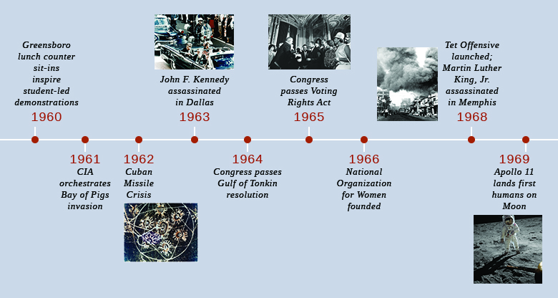

Slide 144
John F. Kennedy (1960-1963)
35th president- Defeated Richard Nixon during election of 1960; First time the debates were televised during inaugural address his famous quote; “ask not what your country can do for you; ask what you can do for your country”
He also announced that the US would put a man on the moon by the end of the decade- happened in 1969- Apollo 11 landed first two men on the moon; Buzz Aldrin and Neil Armstrong
He was an advocate for women’s rights
Also was big on reform; Medicare, civil rights, housing subsidies
Was assassinated November 22, 1963 by Lee Harvey Oswald

Slide 145
Lyndon B. Johnson
36th President (1963-1969)
Pushed civil rights bill through congress as a tribute to Kennedy
“Great Society” programs – comprehensive social legislation – main goal was to eliminate poverty & racial injustice
Introduced Medicare and Medicaid
Project Head Start; help prepare underprivileged kids for elementary school
Medicare - national health insurance program funded by payroll tax, premiums and surtaxes from beneficiaries, and general revenue. Provides health insurance for Americans aged 65 and older who have worked and paid into the system through the payroll tax. It also provides health insurance for younger people with disability status as determined by the Social Security Administration.
Medicaid- joint federal and state program that helps with medical costs for some people with limited income and resources.

Slide 146
Warren Court
Chief Justice Earl Warren; 1953-1969. US Supreme Court expanded the rights of all Americans; court became major instrument of social change
Freedom of Speech
Brown v. Board of Education(1954); segregation in public schools violates the 14th amendment
Equal Representation -> Baker v Carr (1962) court ordered a reorganization of state legislatures on the principal of “one man one vote”
Freedom of Religion – Engel v Vitale (1962) – outlawed the use of school prayers in public schools – court saw it as a violation of the first amendment
Rights of the accused; government must provide a lawyer for anyone accused of a felony
Miranda v Arizona (1966) – suspect must be told of his constitutional rights…remain silent, have an attorney present, etc. - referred to as Miranda Rights
Gideon v Wainwright (1963); Rights of the accused; government must provide a lawyer for anyone accused of a felony
Miranda rights-
You have the right to remain silent. Anything you say can and will be used against you in a court of law. You have the right to have an attorney. If you cannot afford one, one will be appointed to you by the court. With these rights in mind, are you still willing to talk with me about the charges against you?

Slide 147
Vietnam War
US Wanted to stop spread of communism
Armed conflict between Vietnamese and French forces began in 1946 after Japan surrendered. Ho Chi Minh had led an underground struggle against Japanese during WWII. China and the Soviet Union recognized Ho Chi Minhs communist government, however France did not. The U.S. gave assistance to the French to keep control of the noncommunist south. By 1954 America was paying for most of the French war effort. Finally, northern forces forced France to withdraw from Indochina
Indochina – a peninsula directly South of China – countries are Vietnam, Laos, and Cambodia
Ho Chin Minh (revolutionary & communist) After WWII entered Hanoi and declared independence for Vietnam- leader of North Vietnam
French ruled South Vietnam until they were forced out of Indochina in 1954
Geneva Accords (1954)- Rep from Indochina, France , Britain, China, Soviet Union, and the US met to negotiate peace settlement in Indochina. Laos and Cambodia made independent states; Vietnam was divided in two; Ho Chi Minh(communists) in the north, Vietnamese Emperor the south
America’s involvement in Vietnam was due to;
Domino Theory; US leaders feared that if South Vietnam fell to communism then Laos, Cambodia, Thailand and Malaysia would fall like dominoes
South Vietnam had a communist revolutionary army called the Vietcong

Slide 148
Vietnam War
Gulf of Tonkin Resolution – August of 1964 North Vietnamese attacked American ships in international waters in the Gulf of Tonkin; congress voted to give the President extraordinary powers to stop North Vietnam; Years later it was clear that the US ships were protecting South Vietnamese ships in North Vietnamese waters and were bombing North Vietnamese targets
The War Powers Resolution(Act)(1973) allows a President to use U.S. forces in combat in the event of “a national emergency created by attack upon the United States, its territories or possessions, or its armed forces.” But the President also needs to report to Congress within 48 hours of such a military action, and Congress has 60 days to approve or reject it.
1965 President Johnson sent the first ground troops to Vietnam
Why we were unable to win the war – North Vietnam had been fighting to unify country since 1946 and were willing to sustain large losses in doing so; they were able to get supplies from China and Soviet Union. Supply routes to the south (like the Ho Chi Minh Trail) were primitive and easily rebuilt after they were bombed
Tet Offensive January 30 1968 (Vietnamese new year) – Vietcong seized control of many South Vietnamese major cities- US eventually drove them out- showed that the communists were far from beaten.

Slide 149
Vietnam War
Richard Milhous Nixon:
Nixon continues the war – Richard Nixon wins 1968 Presidential election
Only U.S. president to resign from office
Watergate scandal; following a break-in by five men at the Democratic National Committee (DNC) headquarters at the Watergate office complex in Washington, D.C. on June 17, 1972, and President Richard Nixon's administration's subsequent attempt to cover up its involvement
Policy of “Vietnamization” – South Vietnamese assumed brunt of fighting; Nixon gradually withdrew American troops and ended the draft. He also increased bombing missions over North Vietnam.
National Security Adviser Henry Kissinger continued secret negotiations with North Vietnamese in Paris
July 1973 he concluded the Paris Peace Accords; cease fire agreement with North Vietnam based on US troop withdrawal from Vietnam- still able to support south
April 1975 Cambodia and South Vietnam fell to communist North- Saigon (capital of south) falls

Slide 150
Vietnam War
Homefront during Vietnam War;
Doves – wanted US to withdraw from war
Hawks believed it was important to stop the spread of communism
First televised war
US Leaders tried to twist the facts to positive public opinion however the media was able to show facts that contradicted the leaders.
Baby boomers were different than their parents’ generation – they questioned the old wars, objected to bureaucracy and the life style of corporate America – they used recreational drugs. There were lots of war protests all over the country.
1.3 million Vietnamese killed
58,000 Americans killed, thousands more suffered physical and psychological injuries from exposure to American Herbicides – especially Agent Orange
Failure in Vietnam led to American disillusionment in government

Slide 151
Richard millhouse Nixon
-37th President of the United States from 1969 until his resignation in 1974, making him the only U.S. president to resign from office.
- running mate of Dwight D. Eisenhower, the Republican Party presidential nominee in the 1952 election
-ended American involvement in the war in Vietnam in 1973
Was very important in foreign affairs- First US president ever to visit communist China and the Soviet Union
Watergate- five men were caught breaking into Democratic party headquarters at the Watergate complex in Washington, D.C. on June 17, 1972. The Washington Post picked up on the story; reporters Carl Bernstein and Bob Woodward relied on an informant known as "Deep Throat"—later revealed to be Mark Felt, associate director at the FBI—to link the men to the Nixon administration.
Nixon resigned the presidency on August 9, 1974

Slide 152
The Changing Status of Women
The Changing Status of Women
Women’s liberation movement- feminist movement refers to a series of political campaigns for reforms on issues such as reproductive rights, domestic violence, maternity leave, equal pay, women's suffrage, sexual harassment, and sexual violence,
Betty Friedan wrote The Feminine Mystique – the “mystique” was that women always found happiness as housewives and mothers rather than in careers
1966 Friedan and others formed National Organization for Women (NOW)
Equal opportunity in Education Act (1972) – Title IX – prohibited universities and schools receiving federal aid from discriminating in their educational programs, including athletics, on the basis of sex.
ERA (Equal Rights Amendment) – originally proposed by Alice Paul in 1923 submitted to congress every year until it was approved by both houses of congress in 1971. Congress gave states 7 years to ratify, however that never happened.
Roe v Wade (1973) – Supreme Court ruled that women have constitutional right to privacy under 14th amendment. The right of privacy gives a woman an unrestricted right to have an abortion in the first three months of the pregnancy and restricted rights to have an abortion on health grounds in the second three months.

Slide 153
US Foreign Policy Since 1972

Slide 154
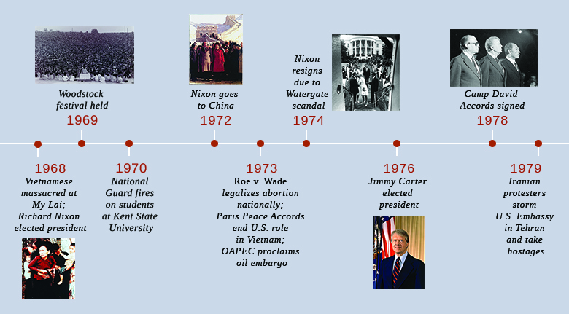

Slide 155
US Foreign Policy Since 1972
Watergate- June 17,1972, burglars arrested in the office of Democratic National Committee, in the Watergate building: They were connected to Nixon’s reelection campaign & caught attempting to wiretap phones and steal secret documents. Nixon tried to cover it up raising “hush money” & trying to stop the FBI from investigating the crime, destroying evidence and firing uncooperative staff members. In August 1974, his role in the conspiracy came to light, the president resigned.
Gerald Ford- 38 president 1974-77succeeded Nixon- only person to serve as president and VP without being elected to either
OPEC- Organization of the Petroleum Exporting Countries an organization of 13 nations, founded 1960 in Baghdad by the first five members (Iran, Iraq, Kuwait, Saudi Arabia, Venezuela), and headquartered since 1965 in Vienna.
PLO (Palestinian Liberation Organization)- founded in 1964 with the purpose of the "liberation of Palestine" through armed struggle, with much of its violence aimed at Israeli civilians.
Camp David Accords- Jimmy Carter (39th president elected 1976)- 1977 organized accords; signed by Egyptian President Anwar El Sadat and Israeli Prime Minister Menachem Begin on 17 September 1978, led directly to the 1979 Egypt–Israel Peace Treaty. Sadat and Begin received the shared 1978 Nobel Peace Prize
1977 Carter signed agreement to turn over Panama Canal to Panama in 2000
Iran Hostage Crisis- standoff between Iran and the US. 52 US diplomats and citizens were held hostage for 444 days from November 4, 1979, to January 20, 1981 after a group of Iranian students took over the U.S. Embassy in Tehran.

Slide 156
American Foreign Policy since 1972
Ronald Regan; 40th President- elected 1980
Withdrew troops from peace keeping mission in Lebanon in 1983
1986- bombed Libya in retaliation to Suicide bomber in West Berlin
Regan Doctrine- wanted to roll communism back, not just contain it
Sent troops to Afghanistan and Grenada to fight communism
Nicaragua- Regan supported the anti-communist rebels (Contras)
Iran- Contra affair- US sold arms to Iran (they needed arms due to Iran-Iraq war), then used the money to help support the Contras in Nicaragua- Congress had prohibited further aid to the contras- this was a big scandal and Regan claimed he had no knowledge of events.
Glasnost- "openness," refers to the Soviet policy of open discussion of political and social issues. The policy was instituted by Soviet leader Mikhail Gorbachev in the late 1980s and began the democratization of the Soviet
1987- Regan speaking in Berlin called on Gorbachev to “tear this wall down”
1988- George HW Bush elected 41st president
Berlin Wall torn down November 1989
1990 Persian Gulf War- Saddam Hussein invaded Kuwait- US troops chased Iraqis forces out

Slide 157
US Foreign Policy Since 1972
Bill Clinton 42nd president elected in 1992- served two terms
Apartheid- a system of institutionalized racial segregation and discrimination in South Africa between 1948 and 1991
Persian Gulf War- Iraq invaded and occupied Kuwait August 1990. Saudi Arabia and Egypt called on US and other Western nations to intervene. Hussein defied United Nations Security Council demands to withdraw from Kuwait. January 1991, Persian Gulf War began with a massive U.S.-led air offensive known as Operation Desert Storm. After 42 days of attacks Pres Bush declared cease-fire on February 28; War initially considered a success for the international coalition; simmering conflict in the region led to 2nd Gulf War–known as the Iraq War–that began in 2003.
Saddam Hussein- President of Iraq, serving in this capacity from 16 July 1979 until 9 April 2003.
NAFTA- agreement with Canada, Mexico, and the US, creating a trilateral trade bloc in North America. Jan 1,1994. goal was to eliminate barriers to trade and investment between the U.S., Canada and Mexico. brought immediate elimination of tariffs on more than one-half of Mexico's exports to U.S. and more than one-third of U.S. exports to Mexico. Within 10 years, all U.S.-Mexico tariffs would be eliminated except for some U.S. agricultural exports to Mexico
Election of 2000- 54th election Rep candidate George W. Bush, narrowly defeated Dem Al Gore. closest election in nation's history, 537 votes separating candidates in decisive state, Florida. Triggered a mandatory machine recount, after which Gore requested recounts in four counties, including South Florida. Litigation ensued ultimately reaching the United States Supreme Court. The high court's contentious 5–4 decision in Bush v. Gore, December 12, 2000, ended a statewide recount ordered by the Florida Supreme Court on December 8

Slide 158
US Foreign Policy Since 1972
September 11, 2001- series of four terrorist attacks by the Islamic terrorist group al-Qaeda September 11, 2001 AA Flight 11 and UA Flight 175, were crashed into North and South towers, of World Trade Center in NY. third plane, AA Flight 77, crashed into the Pentagon. fourth plane, UA Flight 93, steered toward Washington, D.C., but crashed into a field in Pennsylvania, after its passengers tried to overcome the hijackers
Al- Qaeda- militant Sunni Islamist organization founded 1988 by Osama bin Laden and others
Jihad- struggle or fight against the enemies of Islam
American Social Issues (Chap 17);
Gray Panthers- a series of multi-generational local advocacy networks in the United States which confront ageism and many other social justice issues. The organization was formed by Maggie Kuhn in response to her forced retirement from the Presbyterian Church at the age of 65 in 1970
United Farm Workers- (UFW), is a labor union for farmworkers in the United States. originated from the merger of two workers' rights organizations, the Agricultural Workers Organizing Committee (AWOC) led by organizer Larry Itliong, and the National Farm Workers Association (NFWA) led by César Chávez and Dolores Huerta. They became allied and transformed from workers' rights organizations into a union as a result of a series of strikes in 1965, when the mostly Filipino farmworkers of the AWOC in Delano, California initiated a grape strike, and the NFWA went on strike in support. As a result of the commonality in goals and methods, the NFWA and the AWOC formed the United Farm Workers Organizing Committee on August 22, 1966.^{[2]} This organization was accepted into the AFL-CIO in 1972 and changed its name to the United Farmworkers Union

